Slide 1
CE 3500
Transportation Engineering

Slide 2
Introductions
Name
Home town
Something interesting about yourself

Slide 3
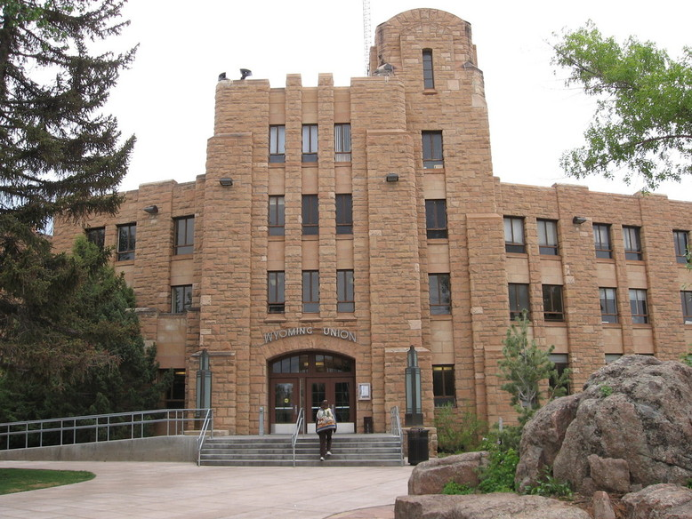
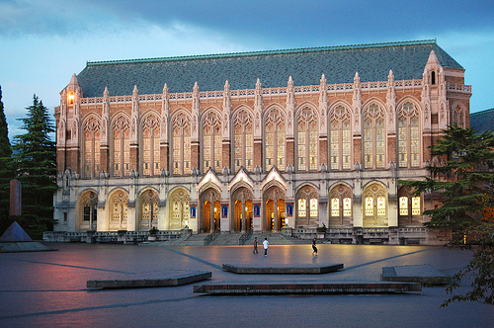
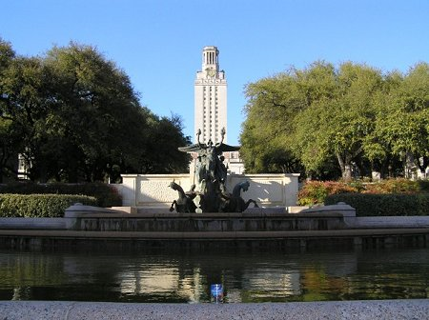
My life in three slides…

Slide 4
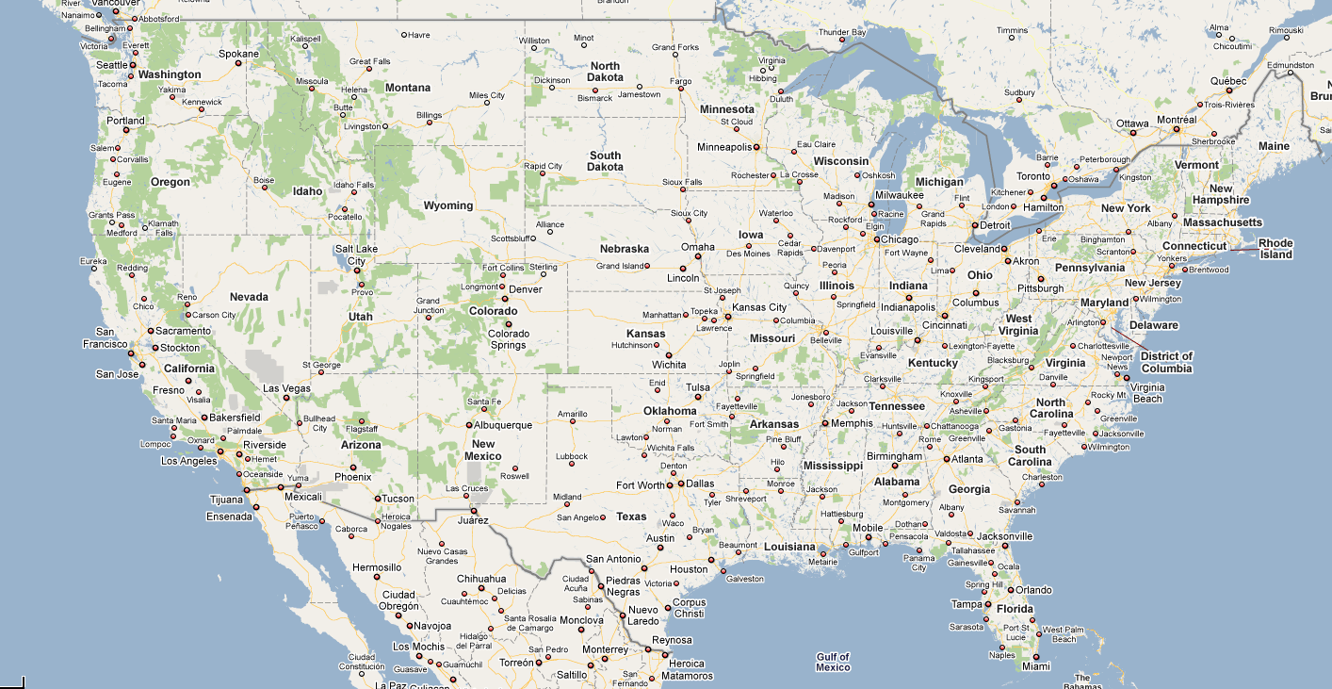
My life in three slides…

Slide 5
My life in three slides…
Ph.D. Student
Assistant Professor
M.S. Student
Undergraduate Researcher
B.S. Student
FLOW Operator

Slide 6
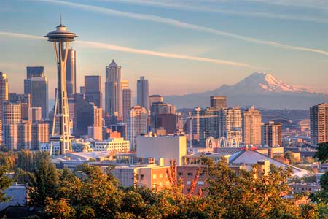
Seattle
Major port city, 3 million residents, major transportation challenge is geography (many mountains, lakes, and rivers)

Slide 7
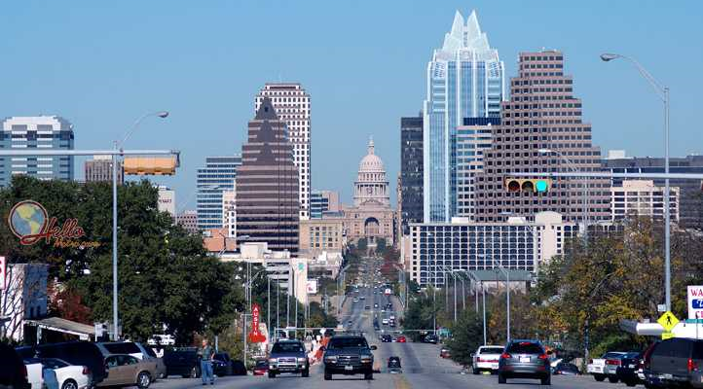
Austin
Capital of Texas, 1 million residents, major transportation challenge is growth (large increase in population in last 20 years).

Slide 8
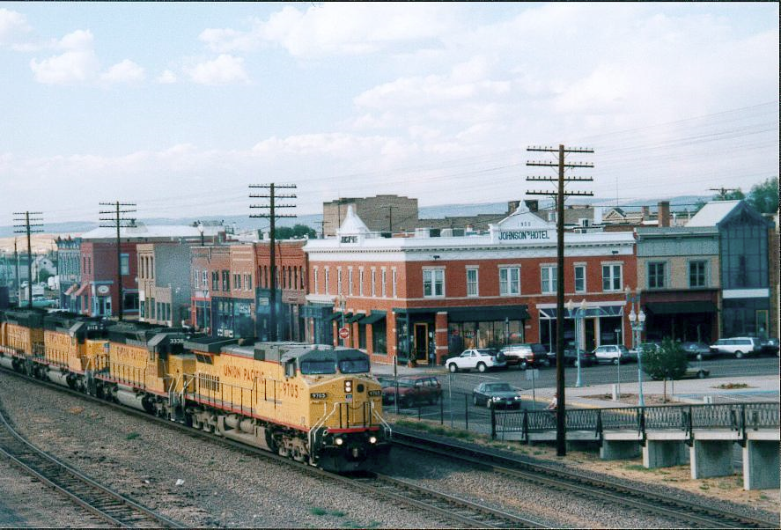
Laramie
25,000 residents and third largest city in the state of Wyoming. Major transportation challenges are safety in cold weather, and maintaining highways with a small budget.

Slide 9
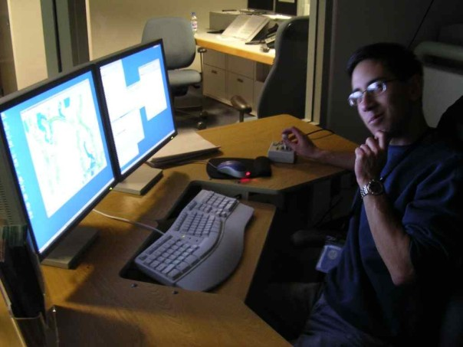
You were a flow what?

Slide 10
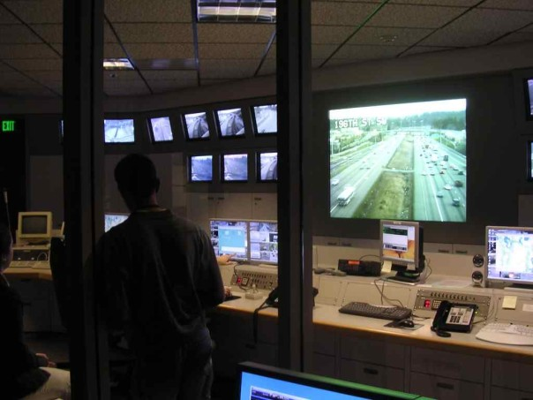
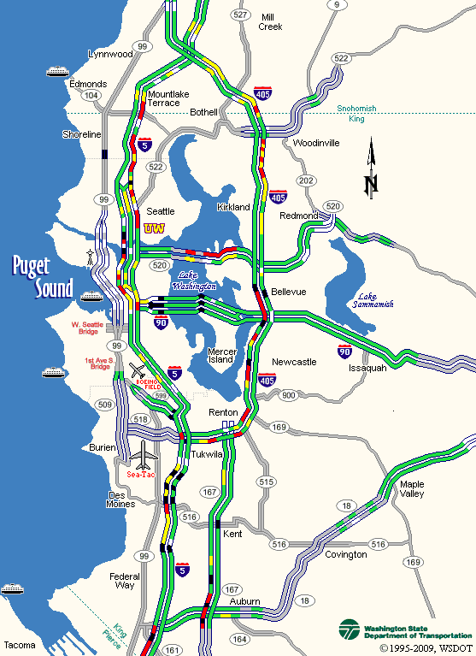
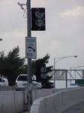
Traffic Management Centers

Slide 11
Syllabus

Slide 12
Note Cards
Name
Area(s) of Interest (Transportation, structures, geotech, water, environmental, undecided)
Math and statistics courses you’ve taken (calculus and higher)
Self-evaluation: rate your skills from 1-5 (5 = excellent) in these areas:
Writing; Math; Excel; MATLAB; Other Programming Languages

Slide 13
What is Transportation Engineering?
Transportation: moving people and goods from one location to another
Modes: driving, train, bus, bicycle, walking, airplane, ship, etc.

Slide 14
What makes a good transportation system?
Low travel times; low construction and maintenance cost; safe; comfortable; low pollution; high capacity; reliable; low cost for users, etc.
Sometimes these goals are in conflict with one another – there is no possible transportation system which can maximize all of these simultaneously.

Slide 15
What purpose do transportation systems serve?
Economic specialization (allows cities and regions to focus their energy on what they can do best and trade with other cities and regions)
Mobility (movement between cities for jobs, visiting family, etc.)

Slide 16
Very broad course outline
Long time span
Large area
Level of detail
Accuracy
I. Planning
II. Operations
III. Design

