Slide 1
CE 3500
Transportation Engineering
Basic Traffic Flow Concepts
February 7, 2011

Slide 2
TRAFFIC OPERATIONS

Slide 3
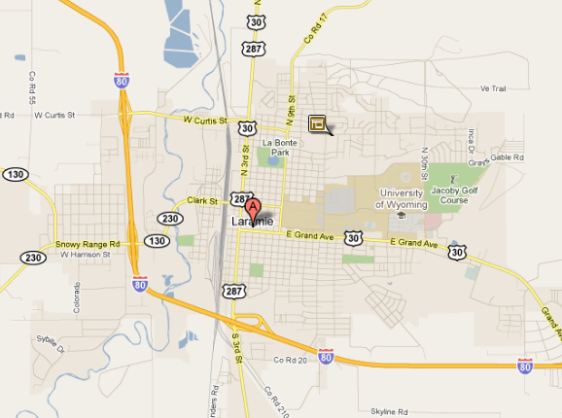
Compared to planning, operations is shorter-term and more localized
By restricting the scope of analysis, we can take a much more detailed look at how transportation facilities function.

Slide 4
Typical operations questions:
How long will people have to wait to turn left from a driveway?
How much delay will people face at this signal?
How do heavy vehicles affect traffic speeds?
What is the “capacity” of a freeway?

Slide 5
Outline of the next few weeks:
Defining basic terminology
Elementary traffic flow theory
(How do uninterrupted roadways work?)
Gap acceptance and queues
(How do controlled intersections work?)
Signal operations
Level of service
(Quantifying how “well” a road or intersection is working)

Slide 6
BASIC TERMINOLOGY

Slide 7
Consider a long, uninterrupted, single-lane roadway:
No passing, no opposing traffic,
no intersections

Slide 8
We can represent a vehicle’s “trajectory” on this road with a two-dimensional graph
Distance (x)
Time (t)

Slide 9
The vehicle’s speed at any point is the slope of its trajectory
Δx
Distance (x)
Δt
Time (t)

Slide 10
We can plot other vehicles’ trajectories on the same diagram
Distance (x)
Time (t)

Slide 11
We can plot other vehicles’ trajectories on the same diagram
Distance (x)
Time (t)
This is called a time-space diagram

Slide 12
This diagram gives us lots of information about the traffic stream.
Distance (x)
Time (t)
Consider a horizontal “slice” of the diagram

Slide 13
The number of trajectories crossing this line is the number of vehicles passing a fixed point on the road.
Distance (x)
Time (t)
This is called the volume or flow, and has units of vehicles per time (usually veh/hr)

Slide 14
What does a vertical slice tell us?
Distance (x)
Time (t)

Slide 15
The number of trajectories crossing this line is the number of vehicles on the road at one instant in time
Distance (x)
Time (t)
This is called the density, and has units of vehicles per distance (usually veh/mi)

Slide 16
Flow | Density
veh/hr | veh/mi
Measured over time at a fixed point | Measured over space at a fixed time
How many vehicles are getting somewhere? | How crowded is the roadway?
Can measure with a point detector | Can measure with an aerial photo
q | k

Slide 17
We can classify the quantities we’ve described so far:
Individual vehicle | Traffic stream
Speed [L/T]
 | Flow [V/T]
 | Density [V/L]

Slide 18
We can classify the quantities we’ve described so far:
Individual vehicle | Traffic stream
Speed [L/T]
 | Flow [V/T]
 | Density [V/L]
Brackets describe units... L = length,
T = time, V = vehicles

Slide 19
Let’s try to fill in the rest of the table.
Individual vehicle | Traffic stream
Speed [L/T]
Time Headway [T] | Flow [V/T]
 | Density [V/L]

Slide 20
The time headway is the time between two vehicles passing a point. (Think of the two-second rule.)
Distance (x)
Time (t)

Slide 21
On a space-time diagram, it is the horizontal distance between two adjacent trajectories
Distance (x)
Time (t)

Slide 22
Method of Successive Averages:
Find shortest paths, get flow vector x* if everybody was to use these paths. Then set x^{i} = (1/i)x* + (1 – 1/i)x^{i-1}
(Find a weighted average of your path flows from the last iteration and the current shortest paths.)

Slide 23
Let’s try to fill in the rest of the table.
Individual vehicle | Traffic stream
Speed [L/T]
Time Headway [T] | Flow [V/T]
Space Headway [L] | Density [V/L]

Slide 24
The space headway is the distance between two vehicles.
Distance (x)
Time (t)

Slide 25
On a space-time diagram, it is the
vertical distance between two
adjacent trajectories
Distance (x)
Time (t)

Slide 26
Let’s try to fill in the rest of the table.
Individual vehicle | Traffic stream
Speed [L/T] | Average Speed [L/T]
Time Headway [T] | Flow [V/T]
Space Headway [L] | Density [V/L]

Slide 27
On the surface, average speed seems easy enough to define. For instance:
A
B
10 mi

Slide 28
I travel from A to B at 10 mi/hr. I then return from B to A at 5 mi/hr. What is my average speed?
A
B
10 mi

Slide 29
Answer 1: You drive ten miles at 10 mi/hr and ten miles at 5 mi/hr. Therefore the average speed is 7.5 mi/hr.
Answer 2: You drive one hour at 10 mi/hr and two hours at 5 mi/hr. Therefore the average speed is 6.7 mi/hr. (6.7 = (2*5 + 10)/3)
Which answer is right?

Slide 30
It depends on what we’re trying to measure. Both are valid in some sense... but the usual definition of average speed is total distance divided by total time.
Which answer is right?

Slide 31
It depends on what we’re trying to measure. Both are valid in some sense... but the usual definition of average speed is total distance divided by total time.
Total distance: 20 mi
Total time: 3 hr
Average speed: 6.7 mi/hr
This is not to say that Answer 1 is completely wrong. But it is not what we are usually interested in.

Slide 32
Another way to look at average speed:
A
5 mi/hr
A
B
5 mi/hr
C
10 mi/hr
C
B
Track circumference 5 mi

Slide 33
Another way to look at average speed:
A
5 mi/hr
A
B
5 mi/hr
5 mi
C
10 mi/hr
C
B
From this aerial photo, it seems obvious that the average speed is (5 + 5 + 10)/3 = 6.7 mi/hr.

Slide 34
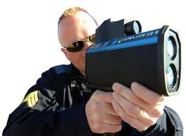
What if we couldn’t get an aerial photo with speeds? Let’s try another approach.
A
5 mi/hr
A
B
5 mi/hr
5 mi
C
10 mi/hr
C
B

Slide 35
After one hour, what speeds will be recorded?
A
5 mi/hr
A
B
5 mi/hr
5 mi
C
10 mi/hr
C
B

Slide 36
After one hour, what speeds will be recorded? A and B pass the radar gun once, C passes the radar gun twice.
A
5 mi/hr
B
5 mi/hr
A
C
10 mi/hr
5 mi
C
C
10 mi/hr
B
Now the average of the four readings is 7.5 mi/hr.

Slide 37
So there are two different types of average speed... we call them time-mean speed and space-mean speed.
Individual vehicle | Traffic stream
Speed [L/T] | Time-mean speed [L/T] Space-mean speed [L/T]
Time Headway [T] | Flow [V/T]
Space Headway [L] | Density [V/L]

Slide 38
Time-mean speed is what the radar gun would give us.
Space-mean speed is what the aerial photo would give us.
Why are they given these names? Let’s go back to the space-time diagram.

Slide 39
Distance (x)
Time (t)
The radar gun is fixed in space but records speeds over time. Therefore you get time-mean speed.

Slide 40
Distance (x)
Time (t)
One way to remember this is by analogy with time headway (which was also measured horizontally)

Slide 41
Distance (x)
Time (t)
The aerial photo is at a single instant in time but records speeds over space. Therefore you get space-mean speed.

Slide 42
Distance (x)
Time (t)
One way to remember this is by analogy with space headway (which was also measured vertically)

Slide 43
Time-mean
Space-mean
A
A
A
A
B
B
5 mi
C
C
C
C
B
B
C
Generally, space-mean speed is what we are interested in. (Time-mean speed is biased towards faster vehicles.)

Slide 44
Time-mean
Space-mean
A
A
A
A
B
B
5 mi
C
C
C
C
B
B
C
However, time-mean speed is much easier to measure (and can be easily automated.)

Slide 45
Luckily, we can calculate space-mean speed from “time-mean” measurements.
Let u_{i} be the speed of the i-th vehicle measured by a point detector (out of n total readings)
B
u₁ =5 mi/hr
A
u₂ =5 mi/hr
C
u₃ =10 mi/hr
C
u₄ =10 mi/hr

Slide 46
The time-mean speed is just the simple average of these: (arithmetic mean)
(5 + 5 + 10 + 10) / 4 = 7.5 mi/hr
B
u₁ =5 mi/hr
A
u₂ =5 mi/hr
C
u₃ =10 mi/hr
C
u₄ =10 mi/hr

Slide 47
The space-mean speed is the harmonic average: the reciprocal of the average of the reciprocals
4 / (1/5 + 1/5 + 1/10 + 1/10)
= 6.7 mi/hr
B
u₁ =5 mi/hr
C
u₃ =10 mi/hr
A
u₂ =5 mi/hr
C
u₄ =10 mi/hr

