Slide 1
CE 3500
Transportation Engineering
Basic Queuing Theory
February 18, 2011

Slide 2
REVIEW

Slide 3
Let’s shift perspective onto the turning vehicle. How long will they have to wait to turn?
What factors would influence this?

Slide 4
These are equal for G = 2.49... the critical gap
Gap (s) | # Accept | # Reject
0 | 0 | 75
2 | 14 | 39
4 | 84 | 7
6 | 110 | 1

Slide 5
Flow (veh/hr) | > 2 s | > 4 s | > 10s
100 | 0.95 | 0.89 | 0.76
500 | 0.76 | 0.57 | 0.25
1000 | 0.57 | 0.33 | 0.06
1500 | 0.43 | 0.19 | 0.02

Slide 6
Example. Vehicles wait to turn onto a road with volume 1000 veh/hr. If the critical gap
is 4 seconds, how many vehicles can turn
in one hour?
(Assume only one vehicle turns in each gap.)
Solution. There are 1000 gaps in one hour. The probability each is greater than 4 seconds
is 0.329. Therefore at most 329 vehicles
can turn.

Slide 7
QUEUING THEORY

Slide 8
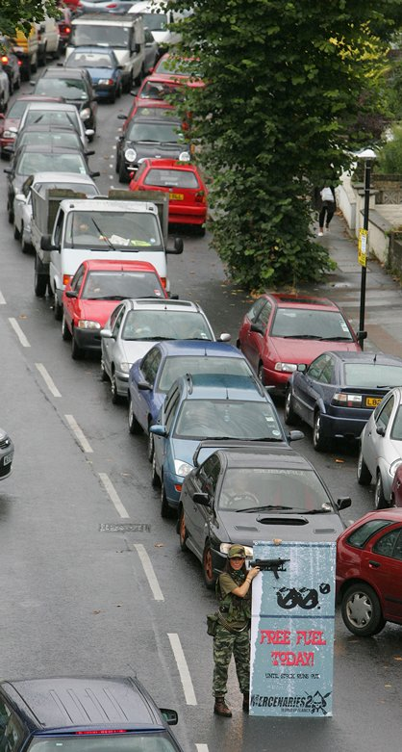
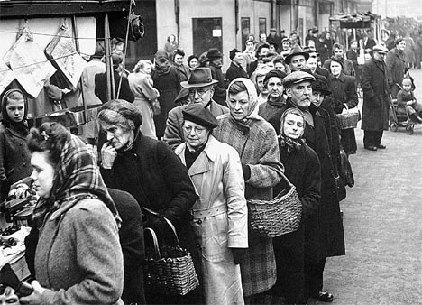
Queuing can be thought of as “the science of waiting in line”

Slide 9
Queue
Arrival
process
Departure process

Slide 10
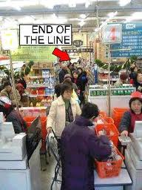
People finish gathering groceries and go to check out
Groceries are scanned, payment is made
Queue
Arrival
process
Departure process

Slide 11
You call customer service
Your problem gets dealt with (or not)
Queue
Arrival
process
Departure process

Slide 12
Wait for light to turn green
Arrive at a red light
Accelerate with the vehicles ahead of you
Queue
Arrival
process
Departure process

Slide 13
Why introduce another way to analyze what happens when traffic stops?
x
IV
III
II
I
t

Slide 14
The queueing theory model
Queue
Arriving vehicles
Departing vehicles

Slide 15
We assume the queue takes up no space
and vehicles simply “stack up”
(“point queue”)
Queue
Arriving vehicles
Departing vehicles

Slide 16
This is less realistic than the shockwave
model, but can handle more complicated
problems.
(Shockwave model quickly falls apart with
variable arrival rates, random departure rate, when people have to wait more than one red light, etc.)

Slide 17
Let’s count vehicles as they enter and leave
the queue.
Queue
Arriving vehicles
Departing vehicles
Arrival counter
Departure
counter

Slide 18
# vehicles
Arrival curve
Departure curve
t

Slide 19
These curves make it very easy to answer
question such as:
What is the average time you wait?
What is the most number of people waiting at any one time?
How long after the green light until the queue is gone?
What is the total amount of delay due to the signal?

Slide 20
# vehicles
Departure curve
Arrival curve
How many people are waiting in queue at this point in time?
t

Slide 21
# vehicles
How long does this vehicle have to wait?
Departure curve
Arrival curve
t

Slide 22
Let’s have a specific example:
Vehicles arrive at 1200 veh/hr
Roadway capacity is 3600 veh/hr
Light is red for 60 s
Find:
Average time stopped
Most number of vehicles in queue
How long after green before queue is gone?
Total delay caused by red light.

Slide 23
Convert to common units:
Vehicles arrive at 1200 veh/hr 20 veh/min
Roadway capacity is 3600 veh/hr 60 veh/min
Light is red for 60 s 1 min

Slide 24
Slope = 60
# vehicles
Slope = 20
1
t

Slide 25
Slope = 60
# vehicles
Slope = 20
1
Average time stopped
=
Average width of triangle
t

Slide 26
Slope = 60
# vehicles
Slope = 20
1
Average time waiting
is 0.5 minutes
t

Slide 27
Slope = 60
# vehicles
Slope = 20
1
Most vehicles in queue is biggest vertical distance between these curves
t

Slide 28
# vehicles
Slope = 20
1 x 20 = 20 vehicles
1
Most vehicles in queue is biggest vertical distance between these curves
t

Slide 29
Slope = 60
# vehicles
Slope = 20
20
1
Time to queue clearance is this distance
t

Slide 30
Slope = 60
# vehicles
Slope = 20
20 + 20t = 60t
t = 0.5
20
1
0.5
t

Slide 31
Slope = 60
# vehicles
Slope = 20
0.5 x 60
=30
20
1
0.5
0.5(1)(30) =
15 veh-min
t

Slide 32
Same approach holds for more
sophisticated examples

