Slide 1
CE 3500
Transportation Engineering
Freeway LOS
February 25, 2011

Slide 2
ANNOUNCEMENTS

Slide 3
Homework: Due Monday, will be graded by Wednesday
Lab tomorrow: EN 3056
Exam next Thursday: Two practice tests posted. You may bring one sheet of notes to the exam.

Slide 4
REVIEW

Slide 5
General procedure:
Establish phases
Identify lane groups and volumes
Identify design lane group for each phase
Calculate clearance intervals
Calculate total cycle length
Allocate green time to phases

Slide 6
Overall procedure:
Divide into lane groups
Find capacity, degree of saturation, and delay for each lane group
Calculate approach delay from lane group delay
Calculate total intersection delay from approach delay

Slide 7
The total intersection delay is used to define a level of service (LOS)
LOS | Average delay (s)
A | <10
B | 10-20
C | 20-35
D | 35-55
E | 55-80
F | >80

Slide 8
FREEWAY LOS

Slide 9
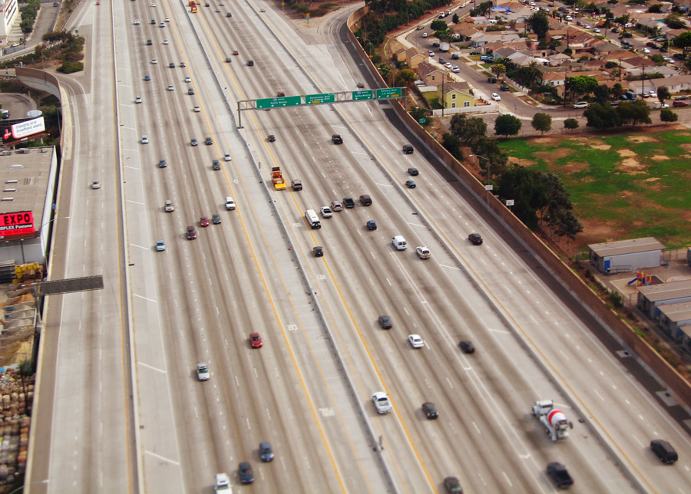
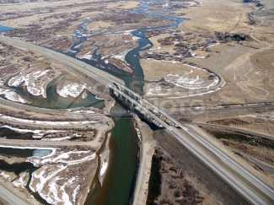
What makes a freeway a freeway?

Slide 10
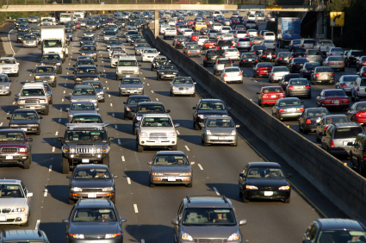
What does it mean for a freeway to be functioning “well” or “poorly?” How can we define a LOS for freeways?
A
F

Slide 11
The primary criterion will be density.
LOS | Density (pcpmpl)
A | <11
B | 11-18
C | 18-26
D | 26-35
E | 35-45
F | >45

Slide 12
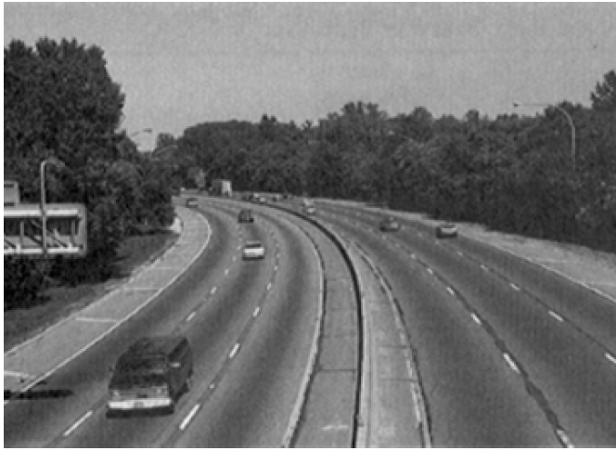
LOS A

Slide 13
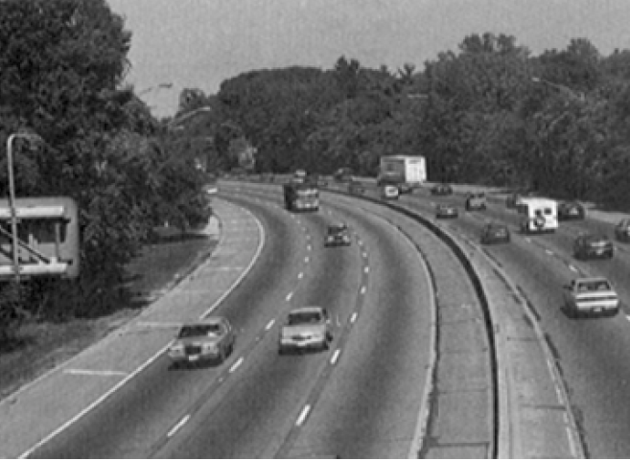
LOS B

Slide 14
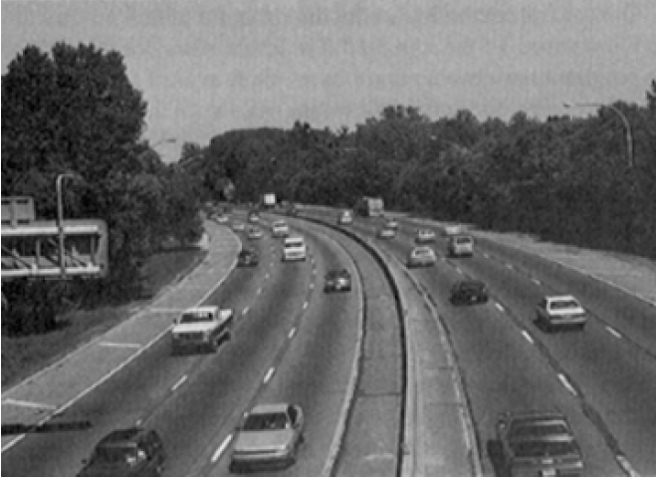
LOS C

Slide 15
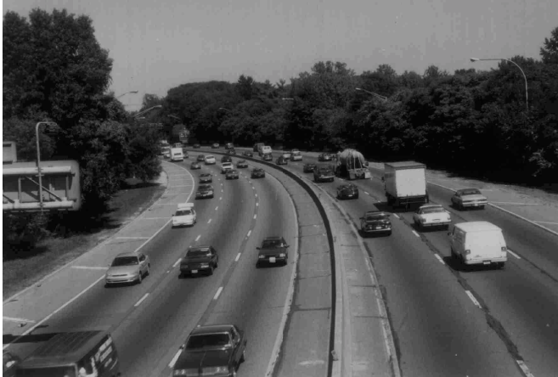
LOS D

Slide 16
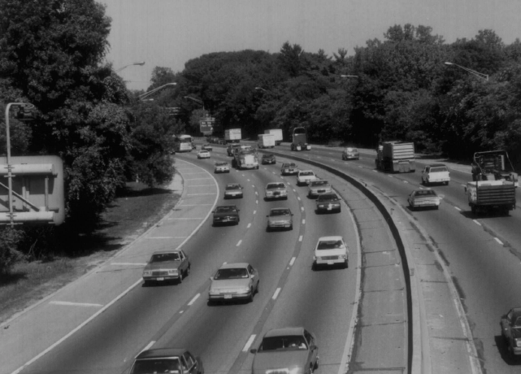
LOS E

Slide 17
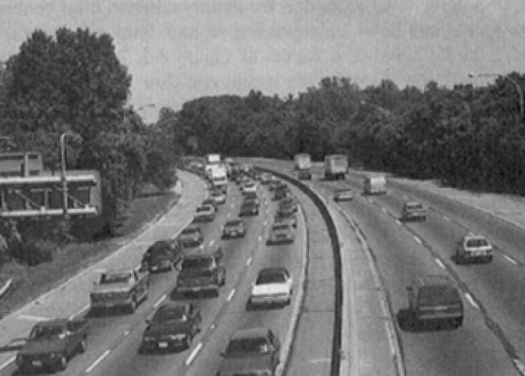
LOS F

Slide 18
When we did shockwaves we assumed a linear speed-density relationship, which led to a quadratic speed-flow relationship.
Speed (u)
Density (k)
Flow (q)

Slide 19
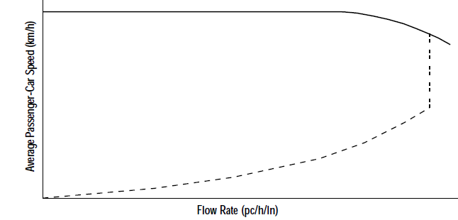
In reality it is not so simple, and speed does not drop until flow is close to capacity.

Slide 20
Fancy speed-flow equations:
If volume is less than 3400-30u_{f}:
Otherwise, if free-flow speed is > 70 mph:
If free-flow speed is ≤ 70 mph:

Slide 21
So, how can we calculate the density on a freeway?

Slide 22
Step 1: Find per-lane volume.
Scaled 15-min. peak volume
Heavy
vehicle
factor
Effective volume
# lanes

Slide 23
How do we find the heavy vehicle factor?
Proportion of trucks and RVs
Equivalency factor... how many “regular vehicles” does it take to have the same effect as one truck or RV?

Slide 24
Table of equivalency factors
Terrain | E_{T} | E_{R}
Level | 1.5 | 1.2
Rolling | 2.5 | 2.0
Mountainous | 4.5 | 4.0
HCM has more detailed tables if you know the exact grade and its length

Slide 25
Step 2: Find speed. If we know the free-flow speed, we can use the fancy equation.
If volume is less than 3400-30u_{f}:
Otherwise, if free-flow speed is > 70 mph:
If free-flow speed is ≤ 70 mph:

Slide 26
So how do we find the free-flow speed?
We take the “base” free-flow speed and adjust it based on specific conditions (just like saturation flow).
Relevant factors:
lane width
shoulder width
number of lanes
interchange density

Slide 27
Base free flow speed
Factors for lane width, shoulder width, number of lanes, and interchange density

Slide 28
Assume base free flow speed is 70 mph for urban freeways and 75 mph for rural freeways.

Slide 29
Lane width factors
Width (ft) | f_{LW} (mph)
12 | 0
11 | 1.9
10 | 6.6

Slide 30
Number of lanes factor
# lanes | f_{N} (mph)
5+ | 0
4 | 1.5
3 | 3.0
2 | 4.5
On rural freeways you do not have to apply an adjustment factor for number of lanes.

Slide 31
(Right-side) shoulder width
factors f_{SW} (mph)
Width (ft) | 2 lanes | 3 lanes | 4 lanes | 5+
6+ | 0.0 | 0.0 | 0.0 | 0.0
5 | 0.6 | 0.4 | 0.2 | 0.1
4 | 1.2 | 0.8 | 0.4 | 0.2
3 | 1.8 | 1.2 | 0.6 | 0.3
2 | 2.4 | 1.6 | 0.8 | 0.4
1 | 3.0 | 2.0 | 1.0 | 0.5
0 | 3.6 | 2.4 | 1.2 | 0.6

Slide 32
Interchange density factor
Interchanges per mile | f_{ID} (mph)
fewer than 0.5 | 0
0.75 | 1.3
1.00 | 2.5
1.25 | 3.7
1.50 | 5.0
1.75 | 6.3
2.00 | 7.5

Slide 33
Putting it all together:
Find effective per-lane volume
Calculate free flow speed
Calculate actual speed from volume
Calculate density from volume and speed
Determine LOS from density

Slide 34
Example: What is LOS on an urban four-lane freeway in rolling terrain with peak 15-minute volume of 2000 veh/hr (5% of which is trucks and 2% RVs)? Lanes are 11 ft wide, shoulders are 10 ft wide, interchanges every two miles.
“Four-lane freeway” means two lanes in each direction.

Slide 35
Step 1: Find effective per-lane volume.

Slide 36
Step 1: Find effective per-lane volume.

Slide 37
Step 2: Find free-flow speed. Urban, so base free flow speed is 70 mph.
Lane width factor: 1.9 mph
Shoulder width factor: 0 mph
Number of lanes factor: 3.0 mph
Interchange density factor: 2.5 mph
Free-flow speed is 62.6 mph

Slide 38
Step 3: Find speed. Free-flow speed is 62.6 mph, and volume (1095) is less than 3400 – 30*62.6, so

Slide 39
Step 4: Find density

Slide 40
Step 4: Find density
LOS B

Slide 41
LOS B

