Slide 1
CE 3500
Transportation Engineering
LOS on other roadway types
March 4, 2011

Slide 2
ANNOUNCEMENTS

Slide 3
Homework due Monday!

Slide 4
Wyoming Summer Undergraduate Internship in Transportation Engineering (WyoSUITE)
Work on a research project with transportation faculty and grad students
Pay is $4200
May 16-August 5 (same as summer session)
To apply, send me
Unofficial transcript
One-page personal statement
Two reference letters
Priority given to applications received by March 31

Slide 5
REVIEW

Slide 6
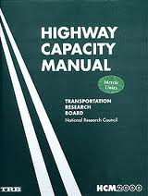

Slide 7
We have looked at LOS for
Traffic signals (based on delay)
Freeways (based on density)
We also saw the HCS software to automate these calculations.

Slide 8
2-LANE HIGHWAY LOS

Slide 9
What is different about two-lane highways? Do we have to change any of the analysis procedure?

Slide 10
Because it is harder to pass, density is not as good a measure of “freedom to drive how you want.” Instead, the HCM uses these criteria:
Average travel speed (ATS)
Percent time spent following (PTSF)

Slide 11
Some concepts are familiar to what we’ve seen before:
Design for peak 15 minute volumes
Heavy vehicle factor, grade factor, lane-width factor, shoulder-width factor, access point factor (but values are different!)

Slide 12
Some things, however, are new:
Passing plays a huge role (especially for PTSF)
If passing is allowed, have to look at traffic volumes in both directions simultaneously

Slide 13
General procedure:
Adjust peak 15 minute volume for grade and heavy vehicles
Use volumes in both directions, and extent of passing zones to calculate PTSF
Calculate free-flow speed by adjusting base speed for lane width, shoulder width, and number of access points
Calculate ATS from free-flow speed and extent of passing zones
Determine LOS from PTSF and ATS

Slide 14
ROUNDABOUTS

Slide 15
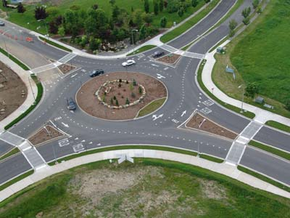
Why are roundabouts getting a lot of attention lately?

Slide 16
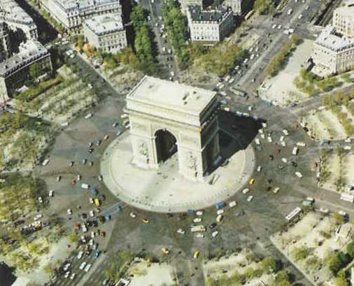

Slide 18
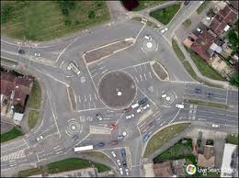

Slide 20
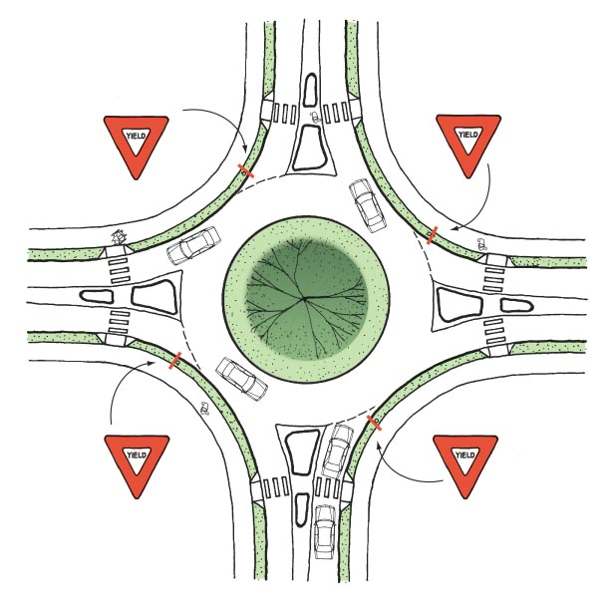

Slide 21
Roundabout advantages:
Less lost time (sometimes)
Safer (why?)
...

Slide 22
Roundabout disadvantages
Unfamiliar
Takes up more space
...

Slide 23
How might we calculate LOS at a roundabout? What factors would this depend on?

