Slide 1
CE 3500
Transportation Engineering
Fancy intersections
March 7, 2011

Slide 2
ANNOUNCEMENTS

Slide 3
I will post solutions for homework at noon tomorrow. No homework accepted after that time.

Slide 4
Wednesday’s class is an exam review: bring any specific questions or problems you want me to work.
Exam is Thursday: one sheet of notes allowed.

Slide 5
REVIEW

Slide 6
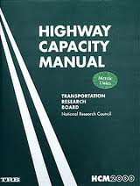
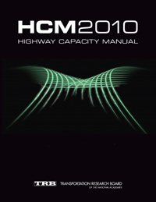

Slide 7
We have looked at LOS for
Traffic signals (based on delay)
Freeways (based on density)
Two-lane highways (based on PTSF and ATS)
We also saw the HCS software to automate these calculations.

Slide 8
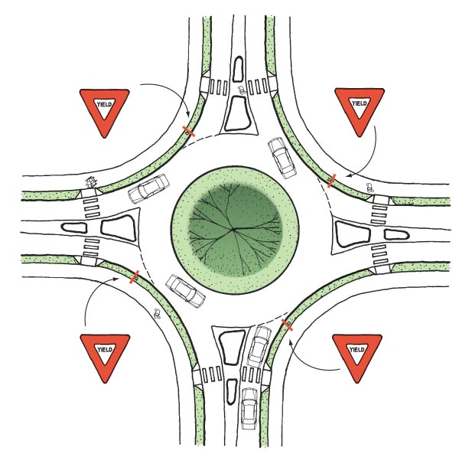

Slide 9
ADAPTIVE SIGNALS

Slide 10
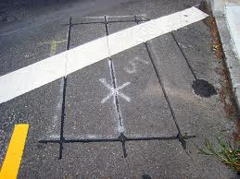
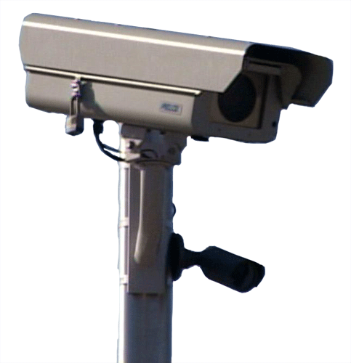
An actuated signal is one that responds to the presence of a vehicle, and adapts the signal phasing and cycle length in real time.

Slide 11
Semi-actuated signals have detectors only on one approach (which one: major street or minor street?)

Slide 12
Fully-actuated signals have detectors on all approaches

Slide 13
When is actuation useful? When is it not useful? What other problems might it have?

Slide 14
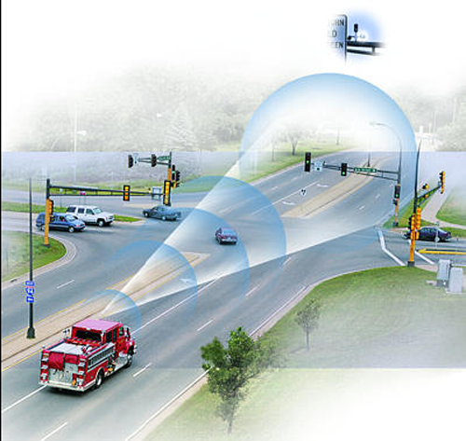
Signal pre-emption: The presence of an emergency vehicle triggers an extended all-red interval.

Slide 15
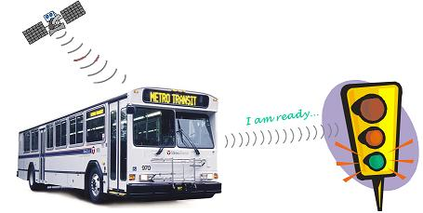
Signal priority: If a bus is approaching and the light is about to turn yellow, extend green time a little longer.

Slide 16
What are some challenges with signal pre-emption and priority?

Slide 17
SIGNAL PROGRESSION

Slide 18
“Once you get a green light, you never have to stop again.”
Why don’t we do this everywhere?

Slide 19
Facts about progression:
Every intersection has to have the same cycle length
In one direction on one street: easy
Both directions on one street: medium to hard
On multiple intersecting streets: next to impossible
Will not work with actuation
Effective at enforcing speed limits
Software exists to help manage a network of signals

Slide 20
FANCIER
INTERSECTIONS

Slide 21
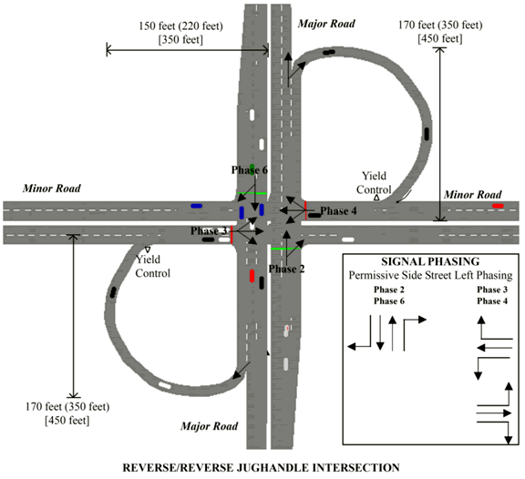
Jughandles:

Slide 22
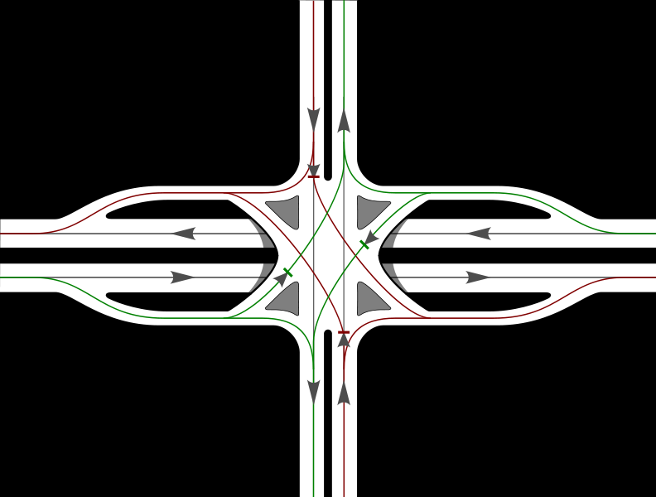
Single-point urban interchange (SPUI)

Slide 23
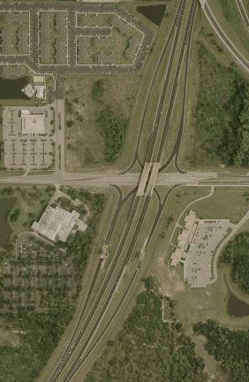
Single-point urban interchange (SPUI)

Slide 24
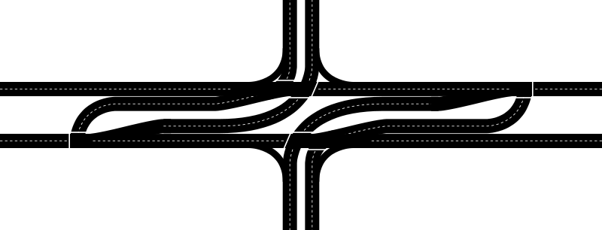
Superstreet

Slide 25
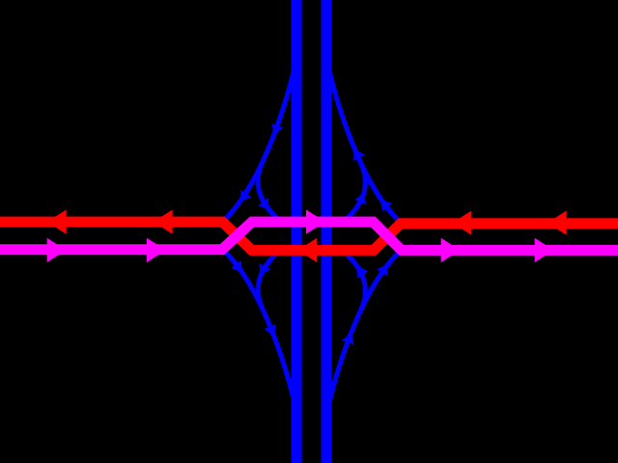
Diverging diamond

Slide 26
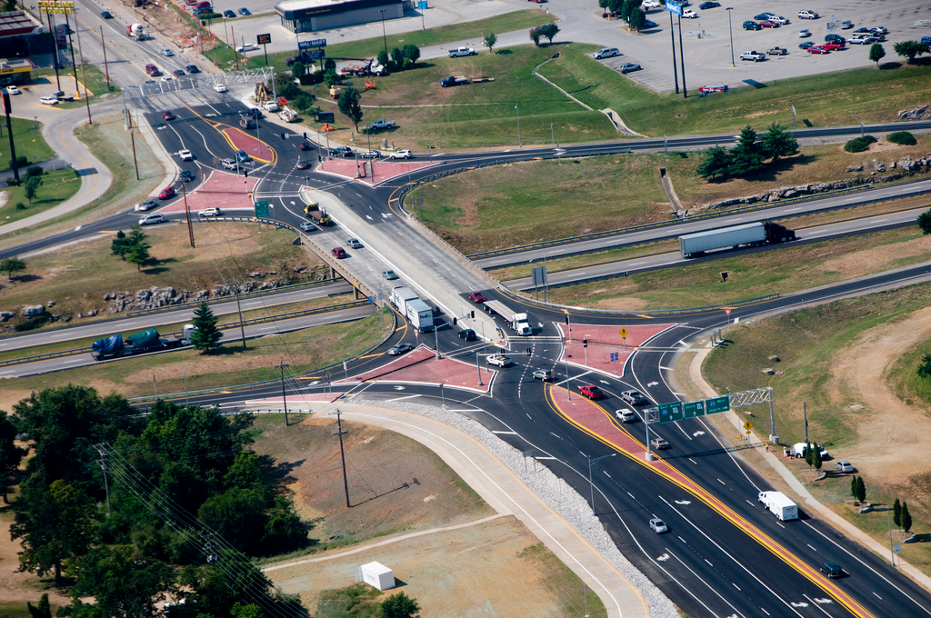
Diverging diamond

