Slide 1
CE 3500
Transportation Engineering
Vehicle and driver characteristics
March 21, 2011

Slide 2
ANNOUNCEMENTS

Slide 3
Group assignment #2 due Friday!

Slide 4
Exam statistics:
Average: 35/50
Standard deviation: 7.8
Max: 48
Average overall grade in the class: 81.3%

Slide 5
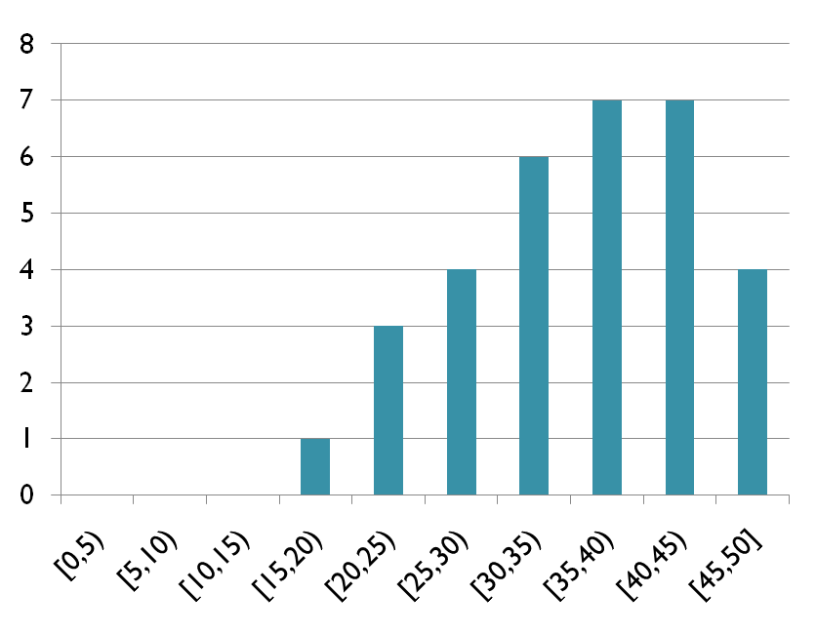

Slide 6
OVERVIEW OF DESIGN

Slide 7
In the next few weeks we’ll talk about:
Vehicle performance
Vertical alignment
Horizontal alignment
Pavement design

Slide 8
In the next few weeks we’ll talk about:
Vehicle performance
Vertical alignment
Horizontal alignment
Pavement design
Think about this as “zooming in” even more than in operations.

Slide 9
Today we’ll focus on vehicle performance. As a preview, “vertical alignment” and “horizontal alignment” can be thought of as the following:
Vertical alignment:
Horizontal alignment:

Slide 10
VEHICLE PERFORMANCE

Slide 11
What is the fastest speed a vehicle can
safely handle a horizontal curve?
How can we answer this?

Slide 12
What is the fastest speed a vehicle can
safely handle a horizontal curve?
Vehicle speed u
Radius of curvature R
How much centripetal force needed?

Slide 13
What is the fastest speed a vehicle can
safely handle a horizontal curve?
Vehicle speed u , mass m
Radius of curvature R
How much centripetal force needed?

Slide 14
What is the fastest speed a vehicle can
safely handle a horizontal curve?
Vehicle speed u, mass m
Radius of curvature R
How much centripetal force needed?
Where does this force come from?

Slide 15
Available force comes from friction:
Coefficient of side friction (typically around 0.14)

Slide 16
So, to travel the curve safely, we need
so
or

Slide 17
What can we do if we don’t have
enough space to design a curve
with radius

Slide 18
Superelevation:
(Now switching to cross-section)
What is the side force now?

Slide 19
Superelevation:
Gravity

Slide 20
Superelevation:
Normal force

Slide 21
Superelevation:
Side friction

Slide 22
What is net force in the direction parallel to the road surface?

Slide 23
What is net force in the direction parallel to the road surface?
How much force do we need?
Therefore

Slide 24
EXAMPLE

Slide 25
A curve has radius 800 ft, side friction coefficient is 0.14, speed limit is 50 mph. Is curve safe? If not, how much superelevation is needed?

Slide 26
STOPPING SIGHT DISTANCE

Slide 27
For traffic signals, we said the stopping distance was

Slide 28
Taking grade into account, we have
Also, we use PIJR time of 2.5s, rather than 1-2 s for signals. Why?

