Slide 1
CE 3500
Transportation Engineering
Horizontal curve examples
April 1, 2011

Slide 2
ANNOUNCEMENTS

Slide 3
Homework 4 due Wednesday
No lab next week either; Dr. Jim Kladianos will be speaking in lab April 14.

Slide 4
REVIEW

Slide 5
Assorted formulae
PI
Δ
E
PT
T
M
Δ/2
C
PC
R
Curve length
Δ

Slide 6
Final answer:
Station | Deflection angle | Chord length (ft)
238+44.75 | 0 | 0
239+00 | 1°6'18" | 55.25
240+00 | 3°6'18" | 99.98
... | ... | ...
252+00 | 27°6'18" | 99.98
252+30.17 | 27°42'30" | 30.17

Slide 7
EXAMPLE

Slide 8
You are designing a curve with a 2000-ft radius. If the tangent length is 400 ft, and PI is at station 103+00, what is the station of PT?
Δ
PI
E
T
M
Δ/2
C
PC
R
Δ

Slide 9
SIGHT DISTANCE
CONSIDERATIONS

Slide 10
Where does sight distance come into play for a curve?
PI
Δ
E
T
M
C
Δ/2
PC
Δ

Slide 11
Idea: consider a segment of the curve as long as the necessary sight distance; find the corresponding middle ordinate length.
SSD
M
Δ

Slide 12
Idea: consider a segment of the curve as long as the necessary sight distance; find the corresponding middle ordinate length.
SSD
M
Δ

Slide 13
EXAMPLE

Slide 14
A horizontal curve on a level two-lane highway with 12-ft. lanes has a 2000 ft. radius, and a 60 mph design speed. Coefficient of braking friction is 0.28. What distance must be cleared from the inside edge of the inside lane?
SSD
M
Why did I give you the number of lanes and lane width?
Δ

Slide 15
FANCY CURVES

Slide 16
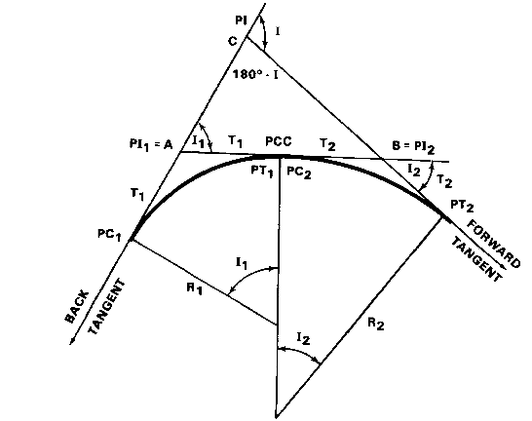
Compound curves: two or more horizontal curves in the same direction

Slide 17
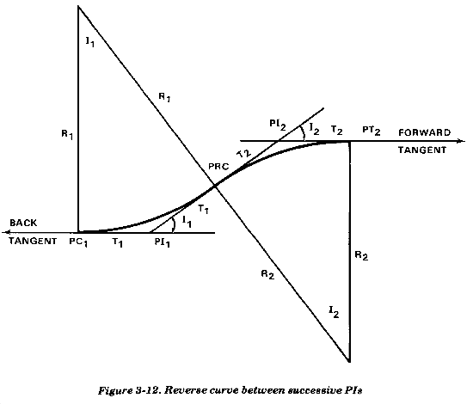
Reverse curves: two or more horizontal curves in opposite direction (often equal radii).

Slide 18
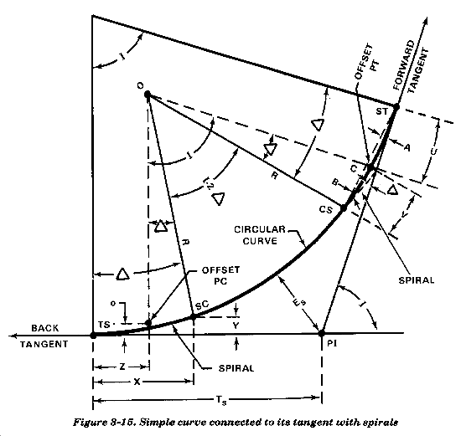
Spiral curves: radius changes during the curve. Often used as a transition between curves and straight segments.

Slide 19
