Slide 1
CE 3500
Transportation Engineering
Introduction to Pavement Materials
April 1, 2011

Slide 2
ANNOUNCEMENTS

Slide 3
Homework 4 due Wednesday
No lab Thursday; Dr. Jim Kladianos will be speaking in lab April 14.

Slide 4
REVIEW

Slide 5
PAVEMENT BASICS

Slide 6
The two main types of pavement:
Asphalt
Concrete

Slide 7
The two main types of pavement:
Asphalt
"Asphalt concrete"
Flexible pavement is the more technical term
Concrete
"Portland cement concrete"
Rigid pavement is the better term
What's the difference?

Slide 8
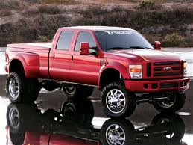
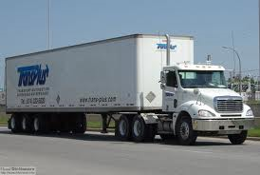
How much damage is caused by different vehicle types?
4000 lb
10,000 lb
90,000 lb

Slide 9
Equivalent single-axle load (ESAL): Converting all vehicle loads to a standard unit (18 kips/axle).
For instance, typical values are:
2,000 kips/axle: 0.0003
10,000 kips/axle: 0.102
20,000 kips/axle: 1.47
30,000 kips/axle: 6.8
50,000 kips/axle: 60.00
(Differs for rigid/flexible pavement and based on pavement condition. I will post tables.)

Slide 10
The formula for ESALs for a particular vehicle type i is:

Slide 11
The formula for ESALs for a particular vehicle type i is:
Design lane factor:
What percentage of total vehicle load is in the "design lane"?
Growth factor: if the traffic load increases by r each year for n years,
G_{rn} = [(1+r)^{n}-1]/r

Slide 12
The formula for ESALs for a particular vehicle type i is:
Average annual daily traffic volume for vehicle class i
Number of axles in vehicle class i
ESAL equivalency factor (from table)

Slide 13
Find ESAL for each class i, then add together to get total ESAL.

Slide 14
EXAMPLE

Slide 15
We are building an 8-lane highway. Estimate AADT is 12,000 with the following distribution:
50% passenger dcars (1000 lb/axle)
33% 2-axle single unit trucks (6000 lb/axle)
17% 3-axle single unit trucks (10,000 lb/axle)
With a growth rate of 4%, design period of 20 years, and predicting 45% of traffic to be on the design lane, what is the total ESAL loading?
(Equivalency factors for the 3 vehicle types are 0.00002, 0.010, and 0.088)

Slide 16
FLEXIBLE PAVEMENT CONCEPTS

Slide 17
Asphalt concrete
Base
Sub-base
Subgrade
When designing a flexible pavement, we have to decide the thickness of the top three layers.

Slide 18
Factors which must be taken into account:
What level of reliability do we want?
How accurate is our volume forecast?
What is the ESAL loading?
How good are the materials being used (resilient modulus, elastic modulus, etc.)
How good is the subbase material? Drainage?
How much damage are we designing for over the life of the pavement?

Slide 19
Factors which must be taken into account:
What level of reliability do we want?
(typically 90%, 95%, 99%)

Slide 20
Factors which must be taken into account:
How accurate is our volume forecast?
Measured by the overall standard deviation (0.2-0.6)

Slide 21
Factors which must be taken into account:
How much damage are we designing for over the life of the pavement?
Initial and final serviceability index

