Slide 1
CE 3500
Transportation Engineering
Trip Generation
January 14, 2011

Slide 2
ANNOUNCEMENTS

Slide 3
No class Monday – disregard syllabus
Notes have been posted to website
Would there be interest in moving classroom to engineering building?

Slide 4
REVIEW

Slide 5
What do we need to do planning?
Zone structure
Network representation
Data source(s)

Slide 6
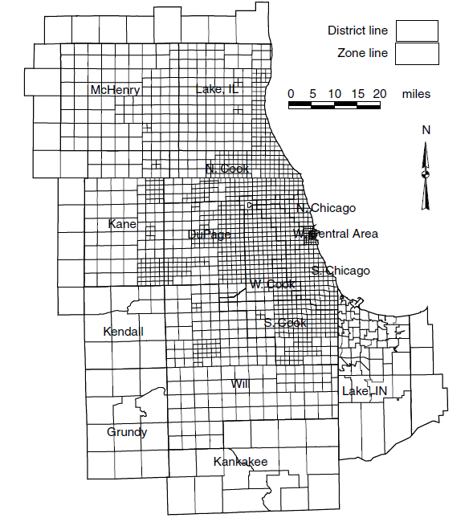
Example: Chicago regional network (1790 zones)

Slide 7
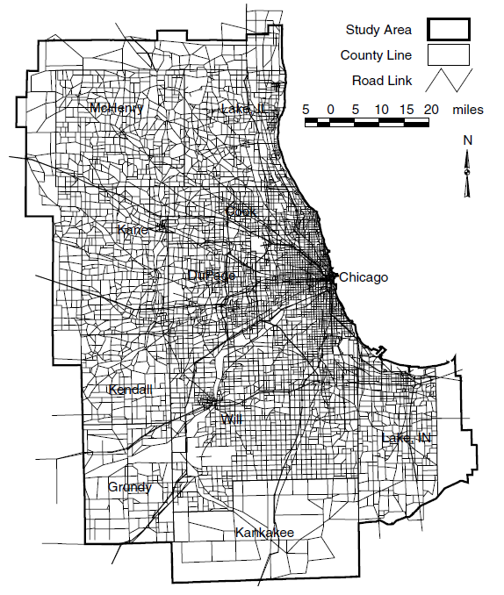
Chicago regional network has ~12,000 nodes and ~39,000 links

Slide 8
Trip generation: What are the total number of trips people make to and from each zone?
Trip distribution: What are the specific origins and destinations for this total number of trips?
Mode choice: How many people will choose to drive, walk, ride bicycles, use transit, etc.?
Route choice: What are the specific routes people will use for their trips?

Slide 9
Example:
Trip generation: How many people arrive at UW every morning?
Trip distribution: How many people are coming to UW from each zone?
Mode choice: How many people will drive, walk, use the shuttle, or ride bicycles?
Route choice: What roads will people choose? (This gives information on congestion!)

Slide 10
Trip generation: How many people arrive at UW every morning?
Trip distribution: How many people are coming to UW from each zone?
Mode choice: How many people will drive, walk, use the shuttle, or ride bicycles?
Route choice: What roads will people choose? (This gives information on congestion!)

Slide 11
TRIP GENERATION

Slide 12
Question #1: How many trips are made by people living in each zone?
Zone
?

Slide 13
Question #2: How many trips are coming to each zone?
Zone
?

Slide 14
Usually, we divide trips by purpose (work, shopping, recreation, etc.)
Zone
Work?
Shop?
Work?
Shop?
Why?

Slide 15
Using travel surveys, we can estimate how many trips a household will make.
Trip
generation
1.5 work trips
0.8 shopping trips
(per day)
3 household members
1 child
2 vehicles owned
Annual income $45,000

Slide 16
We can then scale this up to the entire zone (since we assume a homogeneous population)
6 x 1.5 = 9 work trips
6 x 0.8 = 4.8 shop trips
(per day)
6 households with an average of:
3 household members
1 child
2 vehicles owned
Annual income $45,000

Slide 17
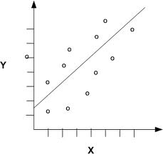
Linear regression is used to relate number of trips made to household characteristics

Slide 18
Linear regression is used to relate number of trips made to household characteristics
Independent variable: Number of trips
Dependent variable(s): Household characteristics

Slide 19
The line is not exact: no household behaves exactly like the model predicts. But on average it is reasonable.
Independent variable: Number of trips
Dependent variable(s): Household characteristics

Slide 20
Example linear regression equation.
Regression coefficients
Work productions (# of work trips)
Dependent variable(s): Household characteristics

Slide 21
Example linear regression equation.
Income
# Vehicles
# Workers
# Household members

Slide 22
Example linear regression equation.
Income
# Vehicles
# Workers
# Household members
Say income is $50,000, household owns 3 vehicles, contains 5 members (2 are employed)

Slide 23
Example linear regression equation.
Income
# Vehicles
# Workers
# Household members
Substituting these values in the equation gives 1.6 work trips per day.

Slide 24
Here’s another equation:
P_{s} = 0.3 + 0.5(# members) + 0.2(# children) + 0.1 (# cars)
How many trips would a household make with 3 cars, 4 members, and 2 children?

Slide 25
Here’s another equation:
P_{s} = 0.3 + 0.5(# members) + 0.2(# children) + 0.1 (# cars)
0.3 + 0.5 x 4 + 0.2 x 2 + 0.1 x 3 = 3.0
How would this number change if they buy one more car?

Slide 26
Here’s another equation:
P_{s} = 0.3 + 0.5(# members) + 0.2(# children) + 0.1 (# cars)
0.3 + 0.5 x 4 + 0.2 x 2 + 0.1 x 4 = 3.1
What if they have another child?

Slide 27
Here’s another equation:
P_{s} = 0.3 + 0.5(# members) + 0.2(# children) + 0.1 (# cars)
0.3 + 0.5 x 5 + 0.2 x 3 + 0.1 x 4 = 3.8
(Adding a child increases both # members and
# children. Be careful! A change in a household may affect more than one characteristic.)

Slide 28
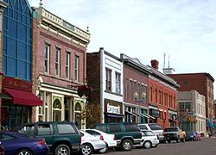
This is the approach used for productions (how many trips do households make?)
A similar approach is used for attractions (how many trips will be coming to a particular place?)
Production
Attraction

Slide 29
Different factors are used, for instance:
Work attractions
(# of people coming to work here)
Household income in this zone
Office space in this zone

Slide 30
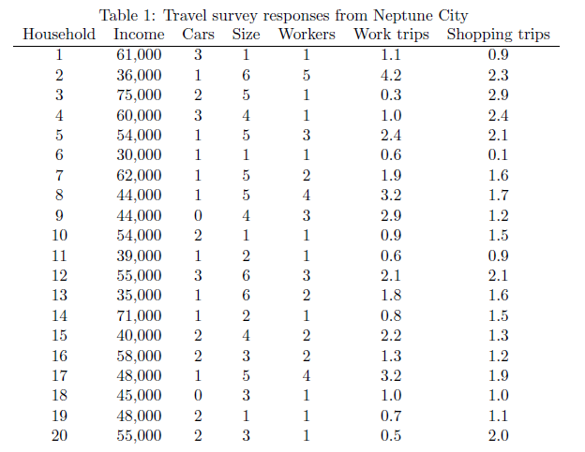
Example from notes:
1. Perform linear regression with survey results (lab next Thursday)

Slide 31
Example from notes:
2. Substitute zone data (from census)

Slide 32
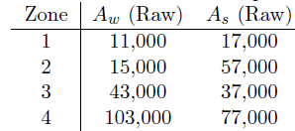
Example from notes:
Production
Attraction
4. Do same with attractions

Slide 33
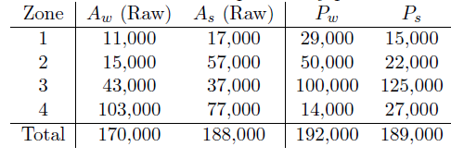
Example from notes:
5. Scale them so they match
(Each trip consists of one production and one attraction: they have to add up to the same)

Slide 34
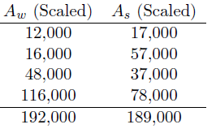
Example from notes:
5. Scale them so they match
Adjust attractions by multiplying them by the right factor so they match productions.

