Slide 1
CE 3500
Transportation Engineering
Introduction to Roadway Safety
April 11, 2011

Slide 2
ANNOUNCEMENTS

Slide 3
Lab Thursday in CR 103.
Practice exams posted.

Slide 4
OVERVIEW

Slide 5
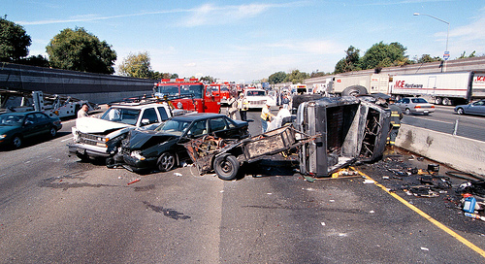
Over 40,000 Americans die annually from roadway crashes

Slide 7
The good news is that the total number (40,000) has stayed the same for many years.
Why is this good news?
Why has this happened?
The bad news is that this is still really, really high.
What can we do about it?

Slide 8
How do we categorize crashes?

Slide 9
What are the main engineering questions
related to roadway safety?

Slide 10
What makes this a challenge?

Slide 11
What should we do about it?

