Slide 1
CE 3500
Transportation Engineering
Basic safety methods
April 8, 2011

Slide 2
ANNOUNCEMENTS

Slide 3
Lab tomorrow: CR 103
Exam next Thursday
Last homework posted; due Monday.
Information on group presentations posted. Will sign up next Monday.

Slide 4
REVIEW

Slide 5
What challenges are faced in safety modeling?
in making transportation systems safer?

Slide 6
HIGHWAY SAFETY
MANUAL

Slide 7
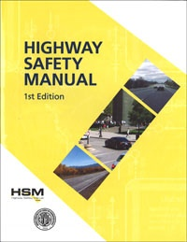
Published by AASHTO; collects and summarizes research results in a practical form. First edition published in 2010.

Slide 8
DEFINITIONS AND
CONCEPTS

Slide 9
Definition of a crash:
"...a set of events that result in injury or property damage due to the collision of at least one motorized vehicle."
Excludes: crashes with no damage;
crash between cycles and pedestrians, etc...

Slide 10
Scale of crash severity
K: One or more fatal injury
A: Incapacitating injury
B: Non-incapacitating injury
C: Possible injury
(not obvious at time of crash)
O: Property damage only
Often called the KABCO scale

Slide 11
Definition of crash frequency:
Crash frequency =
(Number of crashes)/(Period of years)
Can be measured at a particular site, a facility, or over a network.

Slide 12
Expected average crash frequency
Predicted long-run average crash frequency if nothing were to change
What are the advantages and disadvantages of EACF vs. observed crash frequency?

Slide 13
Observed frequency
EACF

Slide 14
Observed frequency
EACF
While harder to predict, EACF is stable, while the observed frequency fluctuates a lot

Slide 15
Regression to the mean: Following a year of very high (or low) crashes, the next year is likely to be closer to the average.
Why is this important?

Slide 16
Lots of crashes this year! Install a raised median.
We can conclude the median reduced crashes by this amount

Slide 17
Lots of crashes this year! Install a raised median.
We can conclude the median reduced crashes by this amount

Slide 18
Lots of crashes this year! Install a raised median.
This is the true effectiveness of the median

Slide 19
It may take years before the new "average" becomes apparent, unless...

Slide 20
Regression to the mean is critical not just in safety modeling, but also in interpreting anything which is even partially subject to chance.
Massachussetts test scores (1999 vs. 2000)
"Sports Illustrated cover jinx"
Pseudoscientific medicine

Slide 21
Highway Safety Manual solution: use lots of data, collected from lots of sites, over many years, to actually measure EACF instead of random variations from year to year.
Main challenge: How can you use data collected at many sites (possibly none of which are in your region?)

Slide 22
Solution: Identify common trends you can use to link any roadway to the data (regression!)
Calibration factor: adjust to local observations if data available
Crash modification factors
Safety performance function: Average number of crashes on a road of this type

Slide 23
Safety performance functions give a "base" estimate of how many crashes will occur. There are different formulas for different kinds of roads. For example:
Rural two-lane highways:
Length in miles
Rural multilane highways:

Slide 24
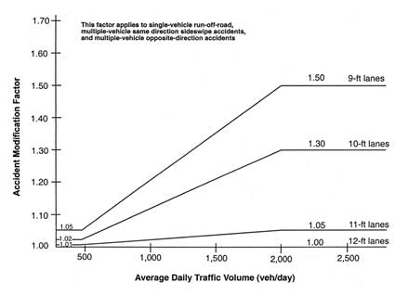
Crash modification factors are based on specific characteristics of a roadway that would lead to more or less accidents than the "base"

Slide 25
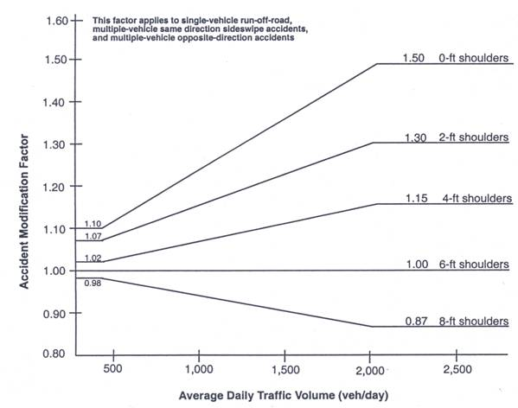

Slide 26
EXAMPLE

Slide 27
Rural two-lane highway segment is 25 miles long, has AADT 5000, and has automated speed enforcement (CMF 0.83). What do we estimate EACF to be?
Rural two-lane highways:
If there is no local data, take C = 1

Slide 28
Let's say that we have seen an average of 25 crashes per year over the last 10 years while AADT has stayed constant. Several new housing developments are planned along this highway, so we expect AADT to increase to 7500 next year. How many crashes do we expect?
Get C value by taking the ratio of observed and predicted crash frequency, then plug in the new AADT

