Slide 1
CE 3500
Transportation Engineering
Trip Distribution
January 19, 2011

Slide 2
ANNOUNCEMENTS

Slide 3
Lab tomorrow in CR 103
Potential room change to EN 3070: email me your votes by Friday

Slide 4
REVIEW

Slide 5
Trip generation: What are the total number of trips people make to and from each zone?
Trip distribution: What are the specific origins and destinations for this total number of trips?
Mode choice: How many people will choose to drive, walk, ride bicycles, use transit, etc.?
Route choice: What are the specific routes people will use for their trips?

Slide 6
Example:
Trip generation: How many people arrive at UW every morning?
Trip distribution: How many people are coming to UW from each zone?
Mode choice: How many people will drive, walk, use the shuttle, or ride bicycles?
Route choice: What roads will people choose? (This gives information on congestion!)

Slide 7
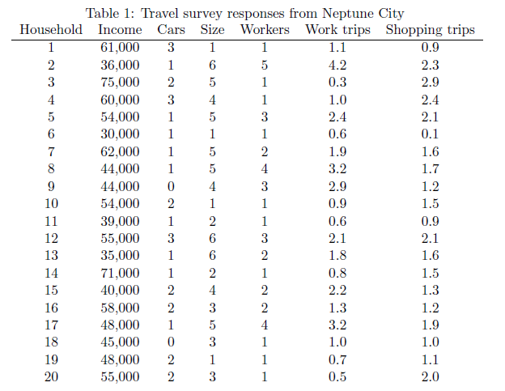
Example from notes:
1. Perform linear regression with survey results (lab next Thursday)

Slide 8
Example from notes:
2. Substitute zone data (from census)

Slide 9
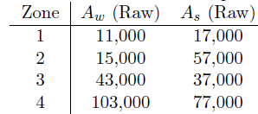
Example from notes:
Production
Attraction
4. Do same with attractions

Slide 10
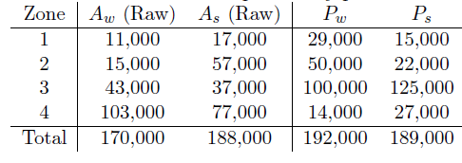
Example from notes:
5. Scale them so they match
(Each trip consists of one production and one attraction: they have to add up to the same)

Slide 11
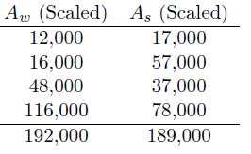
Example from notes:
5. Scale them so they match
Adjust attractions by multiplying them by the right factor so they match productions.

Slide 12
TRIP DISTRIBUTION

Slide 13
Goal of trip distribution:
Convert productions/attractions from step 1:

Slide 14
Goal of trip distribution:
…into an OD matrix

Slide 15
Goal of trip distribution:

Slide 16
So, how do we fill the table so that the row and column sums match what trip generation gave us?

Slide 17
First, a few practical notes.
“OD Matrix” = Origin-Destination Matrix = Trip Table

Slide 18
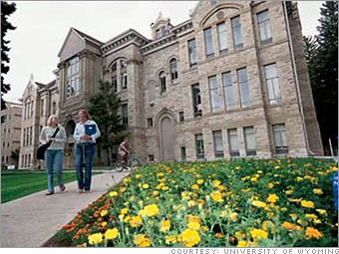
First, a few practical notes.
One “trip” may contain multiple journeys!
Morning
Evening

Slide 19
First, a few practical notes.
One “trip” may contain multiple journeys!
Morning
Evening
Evening

Slide 20
So, we have more than one OD matrix.
AM PEAK
PM PEAK
OFFPEAK
(everything else)

Slide 21
Assumptions in this class:
Each work trip produces one journey from the home zone to the work zone during the AM peak, and one journey from work to home during the PM peak
AM Peak
PM Peak

Slide 22
Assumptions in this class:
Each shopping trip produces one journey from the home zone to the shopping zone during the off-peak, and one journey from shopping to home during the off-peak
Off-peak
Off-peak

Slide 23
More realistic methods are used in practice, but our assumptions give the general idea.
Morning
Evening
Evening

Slide 24
In terms of formulas: for a particular OD matrix, let S denote the number of trips starting in a zone and E the number of trips ending in a zone. Then…

Slide 25
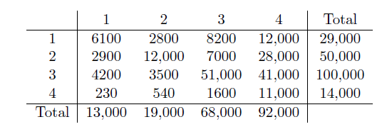
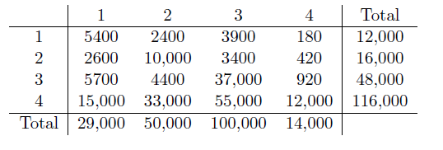
For instance:
AM Peak
PM Peak

Slide 26
Row indicates origin, column indicates destination.
AM Peak
PM Peak

Slide 27
So how do we start filling in this table?
There are a lot of possible answers (16 variables and 8 equations), so we want to pick something which is more reasonable.

Slide 28
How many trips from origin i to destination j? (d_{ij})
A few reasonable assumptions:
The more trips starting at i, the larger the value of d_{ij}
The more trips ending at j, the larger the value of d_{ij}
The greater the distance between r and s, the smaller the value of d_{ij}

Slide 29
A simple formulation:
Friction factor: decreasing function of distance L_{ij}

Slide 30
Writing the proportionality constant and adding an adjustment factor, we have
Adjustment

Slide 31
We need the sum of the entries in each row to add up to the right total, so

Slide 32
We need the sum of the entries in each row to add up to the right total, so

Slide 33
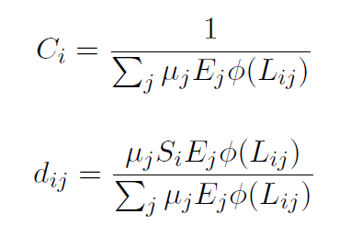
Therefore

Slide 34
This procedure makes sure the rows add up. But we have to make sure the columns add up as well.
This is what the adjustment factors are for. Start off with them equal to 1.

Slide 35
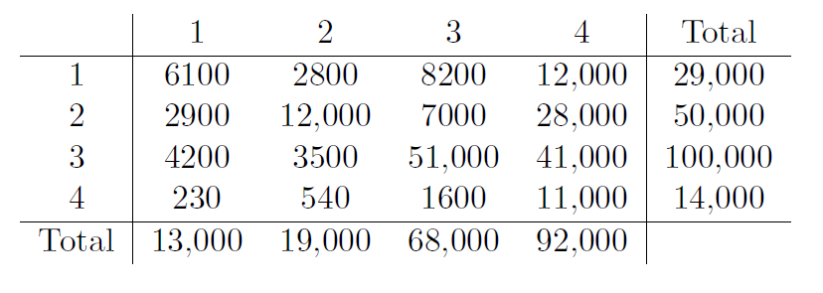
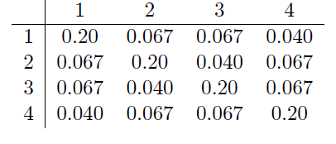
Example:
Friction factors
6100 = 29000 x 13000 x 0.20 / (13000 x 0.20 + 19000 x 0.067 + … + 92000 x 0.040)

Slide 36
Example:
From the formula
Target we’re trying to get:

Slide 37
Example:
Previous adjustment factors
1
1
1
1
New factors:
12/13
16/19
48/68
116/92

Slide 38
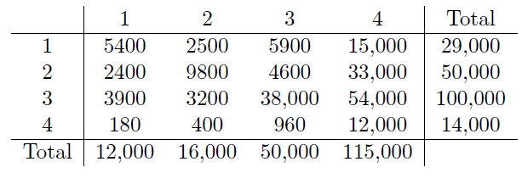
Example:
New table
12/13
16/19
48/68
116/92
New factors:
12/13
16/19
(48/68) x (48/50)
(116/92) x (116/115)

Slide 39
Example:
New table
12/13
16/19
(48/68) x (48/50)
(116/92) x (116/115)

