Slide 1
CE 3500
Transportation Engineering
Mode Choice
January 21, 2011

Slide 2
ANNOUNCEMENTS

Slide 3
No class until next Friday
Classroom will change to EN 3070 starting then

Slide 4
REVIEW

Slide 5
Trip generation: What are the total number of trips people make to and from each zone?
Trip distribution: What are the specific origins and destinations for this total number of trips?
Mode choice: How many people will choose to drive, walk, ride bicycles, use transit, etc.?
Route choice: What are the specific routes people will use for their trips?

Slide 6
So, we have more than one OD matrix.
AM PEAK
PM PEAK
OFFPEAK
(everything else)

Slide 7
Assumptions in this class:
Each work trip produces one journey from the home zone to the work zone during the AM peak, and one journey from work to home during the PM peak
AM Peak
PM Peak

Slide 8
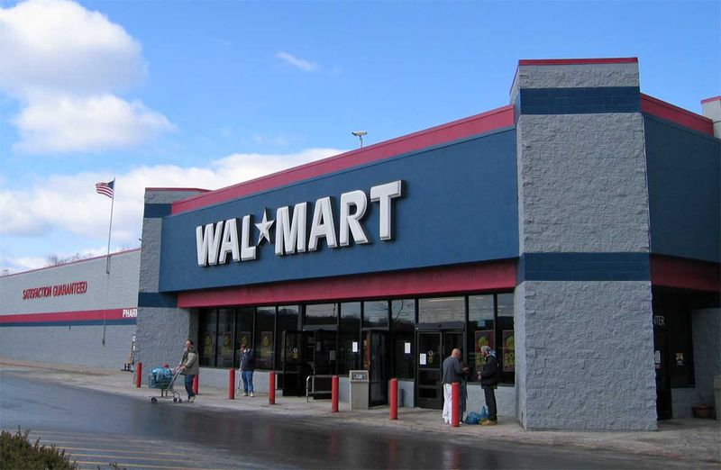
Assumptions in this class:
Each shopping trip produces one journey from the home zone to the shopping zone during the off-peak, and one journey from shopping to home during the off-peak
Off-peak
Off-peak

Slide 9
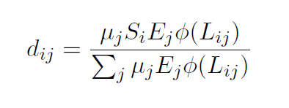

Slide 10
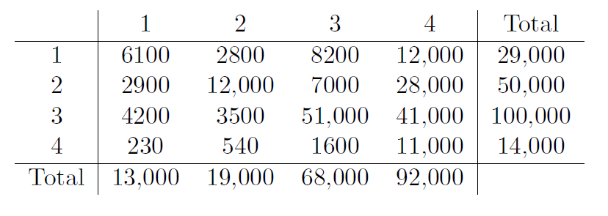
Example:
From the formula
Target we’re trying to get:

Slide 11
Example:
Previous adjustment factors
1
1
1
1
New factors:
12/13
16/19
48/68
116/92

Slide 12
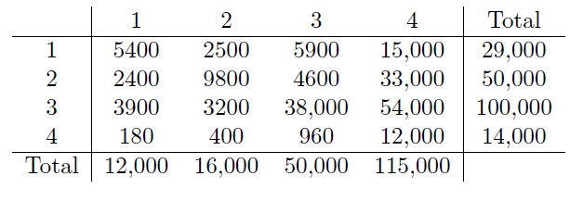
Example:
New table
12/13
16/19
48/68
116/92
New factors:
12/13
16/19
(48/68) x (48/50)
(116/92) x (116/115)

Slide 13
Example:
New table
12/13
16/19
(48/68) x (48/50)
(116/92) x (116/115)

Slide 14
MODE CHOICE

Slide 15
There are literally dozens of potential “modes” of travel:
Passenger vehicle
Drive alone
Carpool
Taxi
Walk
Bicycle
Public transit
Bus
Subway
Light rail
Streetcar
Commuter rail

Slide 16
There are literally dozens of potential “modes” of travel:
Airplane, helicopter, ferry, gondola, rickshaw, covered wagon, horse, etc. etc. etc.

Slide 17
To keep things simple, let’s just assume two modes:
DRIVE PERSONAL VEHICLE
vs.
BUS

Slide 18
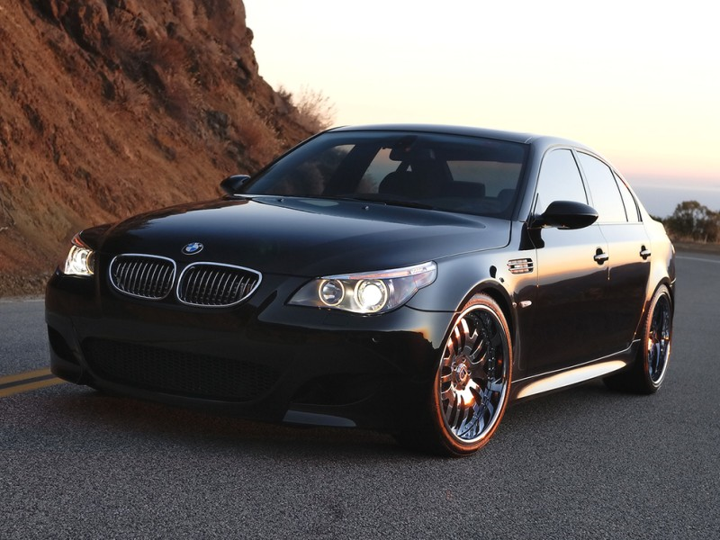
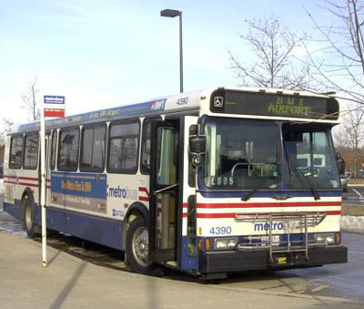
To keep things simple, let’s just assume two modes:
vs.

Slide 19
What factors would affect this decision for you? Why might someone drive, or why might someone ride the bus?
Location (how close to a bus stop)
Convenience
Cost
Travel time
Parking
Health
Hard constraint
Privacy
Control

Slide 20
The fundamental idea is that people choose the option with higher “utility” for them.
Don’t have to find parking or worry about damage to car
Fun to drive, get there fast
Utility is a general economic term for “how happy you are with something” taking everything into account.

Slide 21
Different people and different trip purposes will lead to different utility.
(Road trip)

Slide 22
(The same framework can be applied to any other choice people make.)

Slide 23
(The same framework can be applied to any other choice people make.)
Great taste
Less filling

Slide 24
So, if we can estimate the utility each option provides to people, we can predict what choice they will make.
8,000 people will drive
3,000 people will take bus

Slide 25
We can define a utility function

Slide 26
We can define a utility function
Utility of mode m
Properties of mode m and calibrated coefficients
Unobserved factors

Slide 27
We usually focus on the observed utility
Utility of mode m
Properties of mode m and calibrated coefficients
and deal with the unobserved part later.

Slide 28
For instance
Income
Travel time
Cost

Slide 29
Now we can relate these to the census data, and our knowledge of the transportation system.
We need to generate total numbers of people driving or taking the bus. It’s easier to think in proportions P_{car} and P_{bus}.

Slide 30
A few ground rules:

Slide 31
A few ground rules:
P_{car} is increasing in V_{car}
P_{bus} is increasing in V_{bus}

Slide 32
A few ground rules:
P_{car} is increasing in V_{car}
P_{bus} is increasing in V_{bus}
(because of unobserved part... at least some people will choose each option)

Slide 33
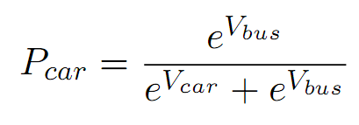
Perhaps the simplest function satisfying these rules is

Slide 34
Perhaps the simplest function satisfying these rules is
(typo in notes)

Slide 35
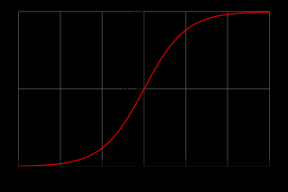
This is the logistic curve:
0
1
Proportion choosing car
0.5
0
V_{car} - V_{bus}

Slide 36
Check:
?

Slide 37
Check:
?
P_{car} is increasing in V_{car}
P_{bus} is increasing in V_{bus}

Slide 38
Check:
?

Slide 39
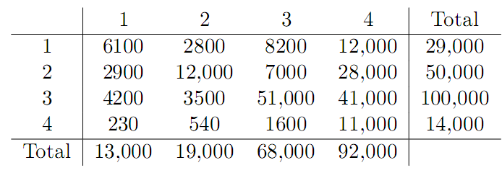
Continuing the example, here is the AM peak OD matrix:

Slide 40
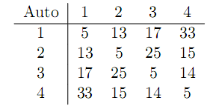
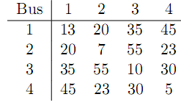
With zone-to-zone travel times and costs by mode, we can use the equation to get mode split.
Travel time (min)

Slide 41
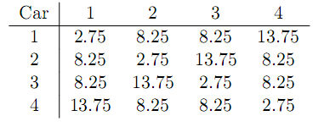
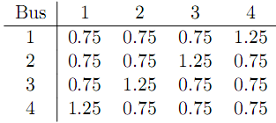
With zone-to-zone travel times and costs by mode, we can use the equation to get mode split.
Cost ($)

Slide 42
We can then calculate the observed utility for each mode.
Census data

Slide 43
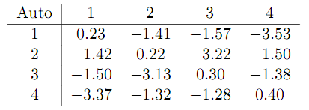
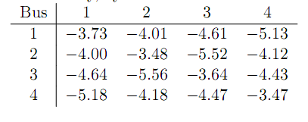
We can then calculate the observed utility for each mode.

Slide 44
Finally, we apply the logistic equation to get mode split.

Slide 45
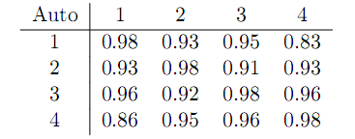
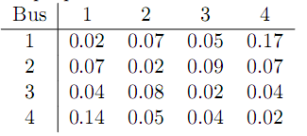
Finally, we apply the logistic equation to get mode split.

Slide 46
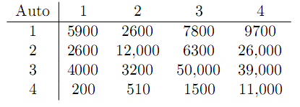
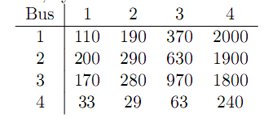
If we multiply by the total number of trips going between each zone (d_{ij}), we get the total number of trips by mode:

