Slide 1
CE 3500
Transportation Engineering
Route Choice
January 28, 2011

Slide 2
ANNOUNCEMENTS

Slide 3
Homework 1 posted on course website, due next Friday.
Group assignment 1 will be distributed and discussed in lab on Thursday

Slide 4
REVIEW

Slide 5
Trip generation: What are the total number of trips people make to and from each zone?
Trip distribution: What are the specific origins and destinations for this total number of trips?
Mode choice: How many people will choose to drive, walk, ride bicycles, use transit, etc.?
Route choice: What are the specific routes people will use for their trips?

Slide 6
ROUTE CHOICE

Slide 7
Again, this is a behavioral question. How do you choose which route to take to school?

Slide 8
The starting point for route choice is to assume that people want to get where they are going as quickly as possible.
5 minutes
15 minutes

Slide 9
But if there are many people, not everybody can choose the same route.
5 minutes
15 minutes
If everybody chooses the top route, it will become congested, and the time will be more than 5 minutes.

Slide 10
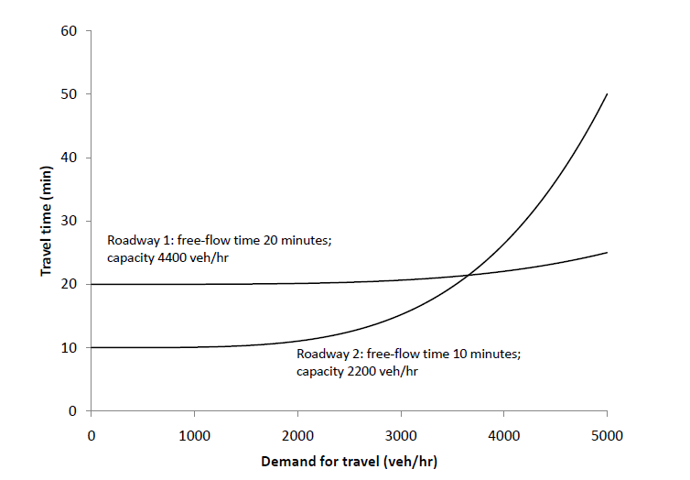
We can represent congestion formation with a link performance function

Slide 11
Link performance functions are increasing: as more people travel on a roadway, its travel time is higher.

Slide 12
Link performance functions are increasing: as more people travel on a roadway, its travel time is higher.

Slide 13
So now we can add link performance functions to route choice.
10 + x
Travel time now depends on the number of vehicles
20 + x

Slide 14
So now we can add link performance functions to route choice.
10 + x
Travel time now depends on the number of vehicles
20 + x
How will these 30 vehicles distribute themselves among the two rotues?

Slide 15
If everybody wants to choose the fastest route, the travel times will be equal. Why?
10 + x
Travel time now depends on the number of vehicles
20 + x
(20 will take the top route, 10 will take the bottom route, travel time is 30 minutes on each)

Slide 16
What would happen if the travel times were unequal?
10 + x
Travel time now depends on the number of vehicles
20 + x
Somebody would switch from the slower route to the faster one! The only stable solution is one where travel times are equal.

Slide 17
In general, there are only two possibilities:
Case I: Both routes are used, and their travel times are equal.
Case II: Only one route is used, and its travel time is faster even when everybody uses it.

Slide 18
We can summarize this as the principle of user equilibrium:
Any used route has equal and minimal travel time among all possible routes connecting that origin and destination.

Slide 19
We can also solve this type of problem graphically:

Slide 20
Re-solve the problem with the following link performance functions:
12 + x
30
20 + x

Slide 21
Re-solve the problem with the following link performance functions:
12 + x
19 vehicles (Travel time 31)
30
11 vehicles (Travel time 31)
20 + x

Slide 22
Re-solve the problem with the following link performance functions:
12 + x
30
45 + x

Slide 23
Re-solve the problem with the following link performance functions:
12 + x
30 vehicles (Travel time 42)
30
0 vehicles
(Travel time 45)
45 + x

Slide 24
The most common link-performance function was developed by the Bureau of Public Roads (BPR)

Slide 25
The most common link-performance function was developed by the Bureau of Public Roads (BPR)
Free-flow travel time
Calibration parameters
Travel time as a function of traffic flow x
Capacity

Slide 26
The most common link-performance function was developed by the Bureau of Public Roads (BPR)
0.15
4

Slide 28
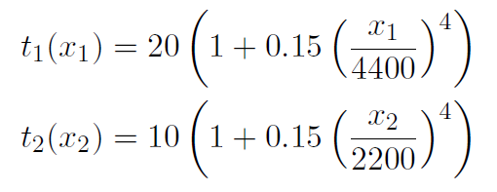
We can re-solve the previous example with more realistic functions. Say
…with travel demand of 7000 vehicles.

Slide 29
Substitute
and we have
Using an equation solver (or guess-and-check, or Newton’s method…) we find

Slide 30
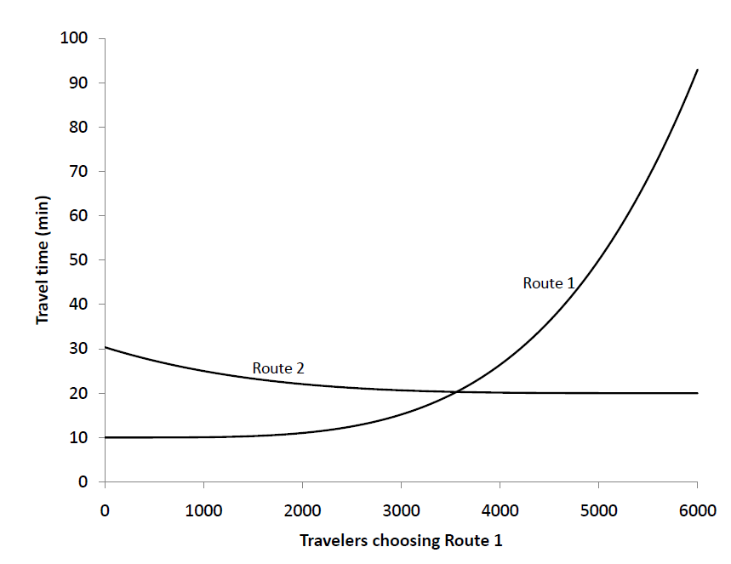

Slide 31
Preview of next week:
Monday: How to solve route choice problems on realistic-sized networks
Wednesday: The Braess Paradox: where the invisible hand goes wrong in route choice
Thursday: Lab; how to do mode choice and route choice; group assignment 1 discussion
Friday: Wrap up planning; how alternatives are compared; Homework 1 due.

