Slide 1
CE 3500
Transportation Engineering
Route Choice
January 31, 2011

Slide 2
REVIEW

Slide 3
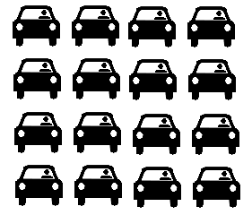
What would happen if the travel times were unequal?
10 + x
Travel time now depends on the number of vehicles
20 + x
Somebody would switch from the slower route to the faster one! The only stable solution is one where travel times are equal.

Slide 4
In general, there are only two possibilities:
Case I: Both routes are used, and their travel times are equal.
Case II: Only one route is used, and its travel time is faster even when everybody uses it.

Slide 5
We can summarize this as the principle of user equilibrium:
Any used route has equal and minimal travel time among all possible routes connecting that origin and destination.

Slide 6
General solution method:
If there are n routes, we need to solve for n unknowns (# of travelers on each route.) There are (n – 1) equations expressing equal travel times, and 1 equation expressing that the total route flows equal the total demand. After solving, verify that the route flows are nonnegative and that no unused routes have lower travel time.

Slide 7
BUT WHAT ABOUT BIG NETWORKS?

Slide 8
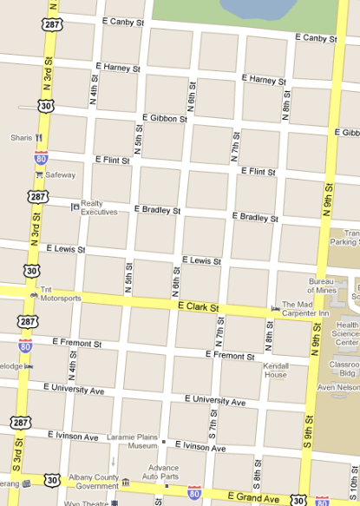
The problem with the “general approach” introduced on Friday is that it scales very poorly to realistic networks.
How many routes?

Slide 9
The problem with the “general approach” introduced on Friday is that it scales very poorly to realistic networks.
How many routes?
2002
And it gets worse if we look at all possible origins and destinations...

Slide 10
Instead, a fundamentally different approach is needed.
Calculate link travel times
Find fastest paths
Shift travelers from slower paths to faster ones

Slide 11
This is an iterative process: we repeat the steps over and over again until we’re “close enough” to equilibrium.
Calculate link travel times
Find fastest paths
Shift travelers from slower paths to faster ones

Slide 12
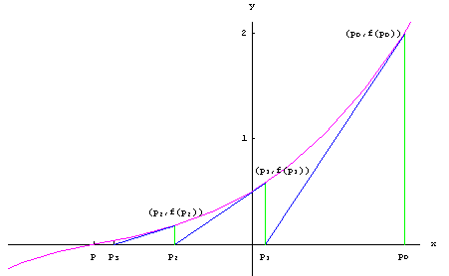
Another iterative method you might recall from calculus is Newton’s Method.

Slide 13
Essentially, we are trading an exact solution procedure (the “general method”) which scales badly, for an inexact one which is more practical.

Slide 14
Step 1 is easy enough: just substitute the current flow values into the link performance functions.
Calculate link travel times
Find fastest paths
Shift travelers from slower paths to faster ones

Slide 15
Step 2 is not much harder either.
Calculate link travel times
Find fastest paths
Shift travelers from slower paths to faster ones

Slide 16
Step 3 is the most difficult one. Why?
Calculate link travel times
Find fastest paths
Shift travelers from slower paths to faster ones

Slide 17
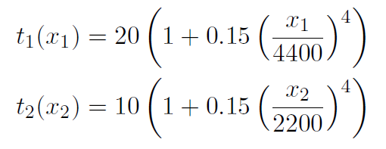
There are two ways to go wrong here. Remember the example from last class?
…with travel demand of 7000 vehicles.
Solution: x₁ = 3376, x₂ = 3623,
t₁ = t₂ = 21.04
(Corrected answer from last time.)

Slide 18
Mistake 1: Shifting too few vehicles.
Link 1 flow | Link 1 time | Link 2 flow | Link 2 time
7000 | 39.22 | 0 | 10.00
6999 | 39.21 | 1 | 10.00
6998 | 39.20 | 2 | 10.00
6997 | 39.18 | 3 | 10.00
... | ... | ... | ...
3377 | 21.04 | 3623 | 21.04
Still get there eventually, just very slowly.

Slide 19
Mistake 2: Shifting too many vehicles.
Link 1 flow | Link 1 time | Link 2 flow | Link 2 time
7000 | 39.22 | 0 | 10.00
0 | 20.00 | 7000 | 163.74
7000 | 39.22 | 0 | 10.00
0 | 20.00 | 7000 | 163.74
... | ... | ... | ...
Now you don’t even converge to the right solution!

Slide 20
So the third step is where we have to be careful.
Idea: Start off moving lots of vehicles, then gradually move less and less.
This leads to the method of successive averages (MSA)

Slide 21
Informal description of MSA:
During the i-th time through the process, shift 1/i of the vehicles onto shortest paths.

Slide 22
Formal description of MSA:
Set iteration counter i = 0
Calculate link travel times (if i = 0, just use free-flow travel time)
Find shortest path between each origin and destination
Shift travelers onto shortest paths:
Find link flows x* if everyone was to use paths from step (3)
If i = 0, x⁰ = x*. Otherwise,
x^{i} = (1/i)x* + (1 – 1/i)x^{i-1}
If close enough to equilibrium, stop. Otherwise increase i by one and go to step 2.

Slide 23
Example: Iteration 0
Free flow travel times are 20 and 10. Link 2 is faster. So x* = [0 7000] and x⁰ = [0 7000]
Iteration | Link 1 flow | Link 1 time | Link 2 flow | Link 2 time
0 | 0 | 20.00 | 7000 | 163.74

Slide 24
Example: Iteration 1
With new travel times Link 1 is faster.
So x* = [7000 0] and
x¹ = (1/1)[7000 0] + (1-1/1)[0 7000]
= [7000 0]
Iteration | Link 1 flow | Link 1 time | Link 2 flow | Link 2 time
0 | 0 | 20.00 | 7000 | 163.74
1 | 7000 | 39.22 | 0 | 10

Slide 25
Example: Iteration 2
With new travel times Link 2 is faster.
So x* = [0 7000] and
x¹ = (1/2)[0 7000] + (1/2)[7000 0]
= [3500 3500]
Iteration | Link 1 flow | Link 1 time | Link 2 flow | Link 2 time
0 | 0 | 20.00 | 7000 | 163.74
1 | 7000 | 39.22 | 0 | 10
2 | 3500 | 21.20 | 3500 | 19.61

Slide 26
Example: Iteration 3
With new travel times Link 2 is still faster.
So x* = [0 7000] and
x¹ = (1/3)[0 7000] + (2/3)[3500 3500]
= [3500 3500]
Iteration | Link 1 flow | Link 1 time | Link 2 flow | Link 2 time
0 | 0 | 20.00 | 7000 | 163.74
1 | 7000 | 39.22 | 0 | 10
2 | 3500 | 21.20 | 3500 | 19.61
3 | 2333 | 20.24 | 4667 | 40.37

Slide 27
...and so on until the travel times are close enough. This is simple and eventually gets you there, but can be glacially slow.
Better idea: Use an adaptive step size. Instead of always moving 1/i of the distance to the target, vary the step size intelligently.
This leads to the Frank-Wolfe algorithm (FW)

Slide 28
Informal description of FW:
When we shift vehicles, shift the proportion of vehicles which gets us as close to equilibrium as possible.

Slide 29
Slightly more mathematical description:
x^{i} = λx* + (1 –λ)x^{i-1}
Proportion of flow shifted to shortest paths
Idea: When we shift vehicles, shift the proportion of vehicles which gets us as close to equilibrium as possible.

Slide 30
What exactly do we mean by “as close to equilibrium as possible?”
x^{i} = λx* + (1 –λ)x^{i-1}
0
λ
1

Slide 31
What exactly do we mean by “as close to equilibrium as possible?”
x^{i} = λx* + (1 –λ)x^{i-1}
0
λ
1
x^{i-1}
x*

Slide 32
What exactly do we mean by “as close to equilibrium as possible?”
x^{i} = λx* + (1 –λ)x^{i-1}
If λ = 0, people will want to shift towards x*
0
λ
1
x^{i-1}
x*

Slide 33
What exactly do we mean by “as close to equilibrium as possible?”
x^{i} = λx* + (1 –λ)x^{i-1}
If λ = 1, people will (probably) want to shift towards x^{i-1} (i.e. λ = 1 is overcorrection)
0
λ
1
x^{i-1}
x*

Slide 34
What exactly do we mean by “as close to equilibrium as possible?”
x^{i} = λx* + (1 –λ)x^{i-1}
Therefore, there is some balancing point in the middle where either x^{i-1} or x*
is equally good.
0
λ
1
x^{i-1}
x*

Slide 35
More precisely, we need
Therefore, there is some balancing point in the middle where either x^{i-1} or x*
is equally good.
0
λ
1
x^{i-1}
x*

Slide 36
More precisely, we need
Old flows
Target flows
Sum over all roadway links
Travel times based on new flows

Slide 37
Writing out more fully, λ satisfies
Another good place to use an equation solver.

Slide 38
Formal description of FW:
Set iteration counter i = 0
Calculate link travel times (if i = 0, just use free-flow travel time)
Find shortest path between each origin and destination
Shift travelers onto shortest paths:
Find link flows x* if everyone was to use paths from step (3)
If i = 0, x⁰ = x*. Otherwise,
x^{i} = λx* + (1 – λ)x^{i-1}
where λ solves the equation on the last slide
If close enough to equilibrium, stop. Otherwise increase i by one and go to step 2.

Slide 39
Example: Iteration 0
Free flow travel times are 20 and 10. Link 2 is faster. So x* = [0 7000] and x⁰ = [0 7000]
Iteration | Link 1 flow | Link 1 time | Link 2 flow | Link 2 time
0 | 0 | 20.00 | 7000 | 163.74

Slide 40
Example: Iteration 1
With new travel times Link 1 is faster.
So x* = [7000 0] and
x¹ = λ[7000 0] + (1- λ)[0 7000]
where λ solves

Slide 41
Left hand side:

Slide 42
Right hand side:

Slide 43
So we need to solve
The solution is λ = 0.482. So
x¹ = λ[7000 0] + (1- λ)[0 7000] =
[3377 3623]

Slide 44
Example: Iteration 1
Iteration | Link 1 flow | Link 1 time | Link 2 flow | Link 2 time
0 | 0 | 20.00 | 7000 | 163.74
1 | 3376 | 21.04 | 3623 | 21.04
We found the equilibrium in just one step!

Slide 45
Each step of FW takes more work, but gets you to the equilibrium faster than MSA.
(For more complicated networks, FW takes more than one step. But it’s almost always much faster than MSA.)

Slide 46
How do we know when to stop? A common criterion is the relative gap:
Sum over all roadway links
Travel time on that link
Flow on that link
OD matrix value from r to s
Time on fastest path from r to s
Sum over all OD pairs

