Slide 1
CE 3500
Transportation Engineering
Route Choice 3
February 2, 2011

Slide 2
ANNOUNCEMENTS

Slide 3
Lab tomorrow... all EN labs already reserved tomorrow afternoon, so still meet in CR 103.
If each group could have a laptop, that would be ideal. (If no group members have one, talk to me and we can make other arrangements.)

Slide 4
REVIEW

Slide 5
We can summarize this as the principle of user equilibrium:
Any used route has equal and minimal travel time among all possible routes connecting that origin and destination.

Slide 6
This is an iterative process: we repeat the steps over and over again until we’re “close enough” to equilibrium.
Calculate link travel times
Find fastest paths
Shift travelers from slower paths to faster ones

Slide 7
Method of Successive Averages:
Find shortest paths, get flow vector x* if everybody was to use these paths. Then set x^{i} = (1/i)x* + (1 – 1/i)x^{i-1}
(Find a weighted average of your path flows from the last iteration and the current shortest paths.)

Slide 8
Frank-Wolfe:
Find shortest paths, get flow vector x* if everybody was to use these paths. Then set x^{i} = λx* + (1 –λ)x^{i-1}
(Find the point in between your path flows from the last iteration and the current shortest paths which is closest to equilibrium.)

Slide 9
More precisely, we need
Therefore, there is some balancing point in the middle where either x^{i-1} or x*
is equally good.
0
λ
1
x^{i-1}
x*

Slide 10
Writing out more fully, λ satisfies
Another good place to use an equation solver.

Slide 11
WHEN DO WE STOP?

Slide 12
Potential idea: stop when the link flows no longer change very much.
x²
x⁴
x⁵
x⁶
x³
x¹

Slide 13
Advantage: Easy.
x²
x⁴
x⁵
x⁶
x³
x¹

Slide 14
Disadvantage: Doesn’t really have anything to do with equilibrium.
x²
x⁴
x⁵
x⁶
x³
x¹

Slide 15
A better method is to see how close our solution x is to the ideal of “equal and minimal” travel times.
To this end we define a “gap function” which is zero if x satisfies the principle of user equilibrium, and positive otherwise.

Slide 16
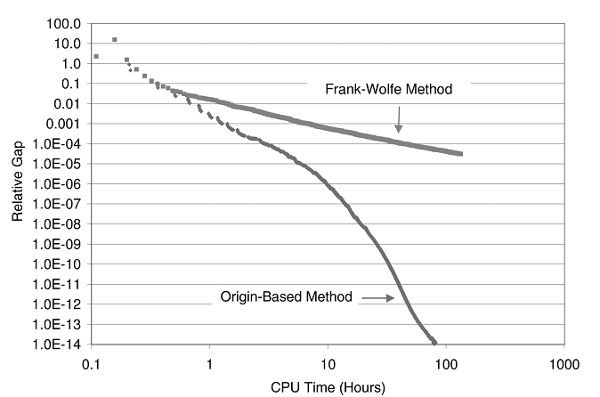
We can then track the progress of the gap over successive iterations. When it is close enough to zero, we are done.

Slide 17
What kind of function would have this property? Consider the equilibrium state when there is just one OD pair.
Every used path has equal and minimal cost; let’s call this cost u
Therefore, the total travel time is ud

Slide 18
What kind of function would have this property? Consider the equilibrium state when there is just one OD pair.
Every used path has equal and minimal cost; let’s call this cost u
Therefore, the total travel time is ud

Slide 19
Another way of calculating the total travel time is to add up the travel time on each path.
If there are k paths with cost c_{i} and flow x_{i}, this gives a total cost of Σc_{i}x_{i}

Slide 20
If this is the equilibrium state, these are equal:
ud = Σc_{i}x_{i}
Otherwise, the left-hand side must be smaller, because u is the fastest path.

Slide 21
Therefore
ud ≤ Σc_{i}x_{i}
and they are equal only at an equilibrium solution.

Slide 22
Therefore
ud ≤ Σc_{i}x_{i}
and they are equal only at an equilibrium solution. This leads to a natural gap function:
⇒ Σc_{i}x_{i} / ud ≥ 1
⇒ Σc_{i}x_{i} / ud – 1 ≥ 0

Slide 23
This is called the relative gap
Σc_{i}x_{i} / ud – 1
When there are multiple origins and destinations it can be written as

Slide 24
Sum over all roadway links
Travel time on that link
Flow on that link
OD matrix value from r to s
Time on fastest path from r to s
Sum over all OD pairs

Slide 25
How small of a gap is needed? Current best practice is 10⁻⁴ to 10⁻⁶, but you need software to get there.

Slide 26
INTERMEZZO

Slide 27
THE BRAESS PARADOX

Slide 28
50 + x
10x
6
6
10x
50 + x

Slide 29
By symmetry, 3 will take top and 3 will take bottom.
Flow
3
50 + x
10x
6
3
6
3
10x
50 + x
3

Slide 30
By symmetry, 3 will take top and 3 will take bottom.
Flow
Travel Time
30
3
50 + x
10x
6
3
53
6
30
3
10x
50 + x
3
53

Slide 31
The equilibrium travel time is 83.
Flow
Travel Time
30
3
50 + x
10x
6
3
53
6
30
3
10x
50 + x
3
53

Slide 32
What if we add a new link?
Flow
Travel Time
30
3
50 + x
10x
6
3
53
6
0
10 + x
10
30
3
10x
50 + x
3
53

Slide 33
The middle path is now faster: 70 < 83
Someone will switch... say, from the top route.
Flow
2
50 + x
10x
6
3
6
1
10 + x
3
10x
50 + x
4

Slide 34
Still not equilibrium: the bottom path is slower than the middle one.
Flow
Travel Time
30
2
50 + x
10x
6
3
52
6
1
10 + x
11
40
3
10x
50 + x
4
53

Slide 35
The middle path is now faster: 70 < 83
Someone will switch... say, from the top route.
Flow
2
50 + x
10x
6
4
6
2
10 + x
2
10x
50 + x
4

Slide 36
OK, all travel times are equal... but have increased from 83 to 92.
Flow
Travel Time
40
2
50 + x
10x
6
4
52
6
2
10 + x
12
40
4
10x
50 + x
4
52

Slide 37
What happened?
Flow
Travel Time
40
2
50 + x
10x
6
4
52
6
2
10 + x
12
40
4
10x
50 + x
4
52

Slide 38
Implications of the Braess paradox
Adding capacity will not always help. (And in fact it might even hurt.)

Slide 39
Implications of the Braess paradox
Adding capacity will not always help. (And in fact it might even hurt.)
We need to do route choice. “Engineering judgment” and intuition can fail horribly.

Slide 40
Implications of the Braess paradox
Adding capacity will not always help. (And in fact it might even hurt.)
We need to do route choice. “Engineering judgment” and intuition can fail horribly.
The invisible hand can go awry in transportation systems.

Slide 41
Why is this the case? Why does the “free market” leave everybody worse off in this case? (If we force people to stay on their original path, everybody gets there faster)
The invisible hand can go awry in transportation systems.

Slide 42
It is because of congestion externalities: one person’s choice has impacts on someone else who had no say in the matter.
Economists would say the problem can be corrected by pricing the externality... charging a toll

Slide 43
But that topic will have to wait for later...
Economists would say the problem can be corrected by pricing the externality... charging a toll

Slide 44
