Slide 1
CE 3500
Transportation Engineering
Wrap-up of planning
February 2, 2011

Slide 2
ANNOUNCEMENTS

Slide 3
HW 1 due today!

Slide 4
REVIEW

Slide 5
Four step model
Trip generation: How many people arrive at UW every morning?
Trip distribution: How many people are coming to UW from each zone?
Mode choice: How many people will drive, walk, use the shuttle, or ride bicycles?
Route choice: What roads will people choose? (This gives information on congestion!)

Slide 6
The equilibrium travel time is 83.
Flow
Travel Time
30
3
50 + x
10x
6
3
53
6
30
3
10x
50 + x
3
53

Slide 7
All travel times are equal... but have increased from 83 to 92.
Flow
Travel Time
40
2
50 + x
10x
6
4
52
6
2
10 + x
12
40
4
10x
50 + x
4
52

Slide 8
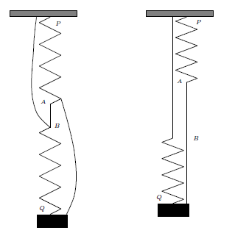

Slide 9
SO HOW DOES THIS ALL WORK IN PRACTICE?

Slide 10
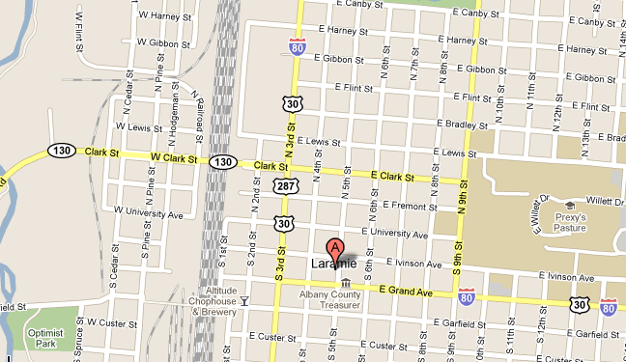
Let’s go back to alternatives analysis.

Slide 11
Here are the factors we decided were important in this decision:
Politics; direct route; amount of pedestrians (safety); cost; public support; neighborhood traffic

Slide 12
For different projects, other “measures of effectiveness” might include air quality, congestion relief, effect on public transit, pavement deterioration, etc.
The four-step model is what tells us what the impacts will be on these factors.

Slide 13
For instance:
Direct route? Calculate new travel times using route choice and LPFs
Safety? A big part of safety models is traffic volumes (route choice)
Neighborhood traffic? Traffic volumes answer this too (route choice)

Slide 14
We can now compare the alternatives:
Alternative | Cost | Safety | Average travel time
A | $15 million | 0.8 accidents/yr | 5.8 minutes
B | $2 million | 4.3 accidents/yr | 5.8 minutes
C | $1.5 million | 1.5 accidents/yr | 8.3 minutes
(The final decision is heavily political; in planning, engineering serves a supporting role.)

Slide 15
Every urban area with a population over 50,000 is required to have an MPO (metropolitan planning organization)
(How can they be forced to do this?)

Slide 16
There are two MPOs in Wyoming

Slide 17
Each MPO is required to produce two transportation plans:
Long-Range Transportation Plan (LRTP)... identify needs over ~20-30 year time horizon
Transportation Improvement Plan (TIP)... shorter-term, what projects are needed in next ~5 years

Slide 18
General course of action:
Predict demographics 20-30 years into the future.
Run four-step model, get “do nothing” conditions.
Identify long-term needs, generate LRTP and start identifying potential projects.
For each potential project, run four-step model again to get measures of effectiveness.
Schedule best projects in TIP, begin design process.

Slide 19
Challenges in MPOs and planning...

