Slide 1
Getting Ahead Before you Fall Behind
How to Succeed in College

Slide 2
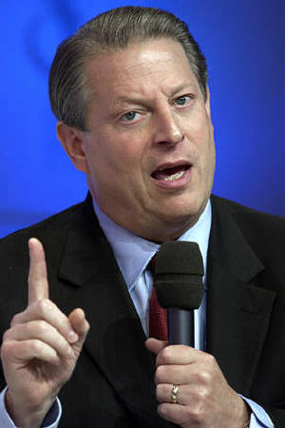
First, a few inconvenient truths…

Slide 3
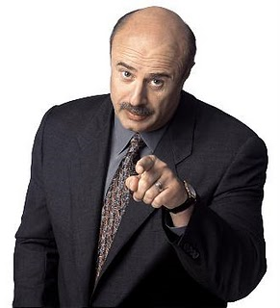
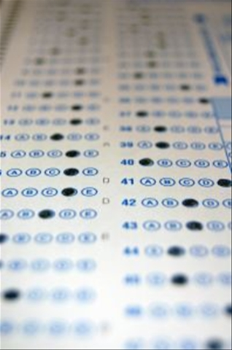
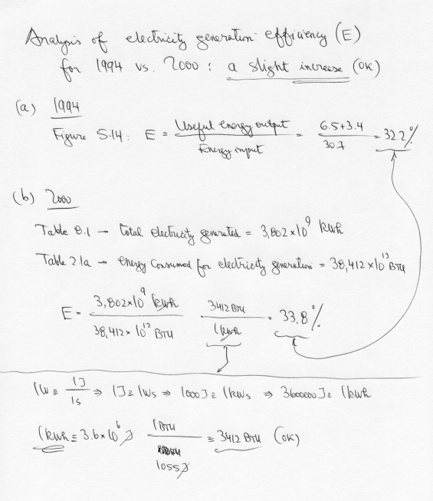
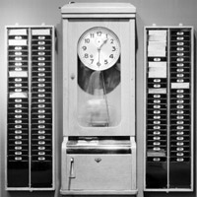
You will get behind at some point in college.
Relationship drama!
Four tests in one week!
Three assignments due the same day!
Have to work extra hours to cover for someone!

Slide 4
It won’t always be fun.

Slide 5
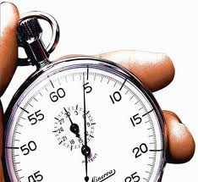
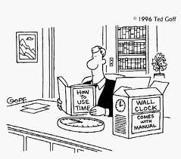
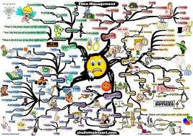
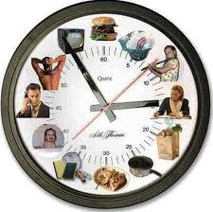
What is time management?

Slide 6
Why is it more important in college?
More multitasking
More autonomy
+ Less urgent deadlines
-------------------------------
= Trouble unless you can keep track of things

Slide 7
Covey’s Categorization Scheme
Different levels of organization:
First generation: reminders
Second generation: advance planning, goal setting
Third generation: prioritization
Fourth generation: efficiency; goals control most of what you do; importance trumps urgency in your schedule

Slide 8
A caveat
Every person is different. No one strategy works for everyone.
The solution? Approach it like a scientist. Do experiments until you find something that works. If a strategy doesn’t work, figure out why, and adapt accordingly.

Slide 9
Your “assignment”
Identify goals:
Short-term (this week)
Medium-term (this year)
Long-term (5-10+ years)
For the next week, try one or more of the strategies presented today (or others). See what works for you (or what doesn’t.)

Slide 10
To-do list
Every morning, make a list of everything you need or want to get done; work down the list.
Advantage: Simple
Disadvantage: Tends to focus on short-term needs rather than long-term goals

Slide 11
ABC-123
A fancier to-do list. Mark each item as either A, B, or C.
A = urgent; has to be done today.
(important enough that you should work late to finish it)
B = want to do today, but OK if you don’t
(not important enough to stay late to finish)
C = would like to do, but not urgent
(not important enough to stay late to finish)

Slide 12
ABC-123
Then, further classify each item with 1, 2, or 3, and sort.
A1 – Make presentation for seminar
A1 – Talk to Avi about NSF proposal
A2 – Read other NSF calls to get ideas for proposals
A3 – Call Sherm at WYDOT to get data
B1 – Plan ahead for networks class
B1 – Do a TRB review
B2 – Finish reading papers for TRB reviews
B2 – Email my paper to Dirck van Vliet
B3 – Look at international travel grant
C1 – Scan chapter from library book
C2 – Debug traffic assignment code
C3 – Check on VISTA
Advantage: Better prioritization
Disadvantage: Focus is on urgent things, rather than important things. Still a short-term focus.

Slide 13
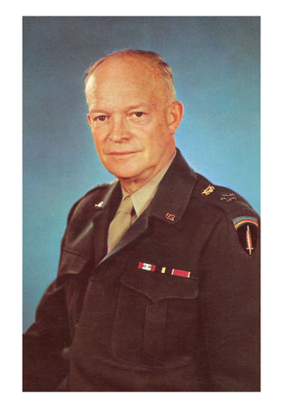
Eisenhower Square
“What is important is seldom urgent, and what is urgent is seldom important.

Slide 14
Eisenhower Square
 | Urgent | Not Urgent
Important
Not Important
Advantage: Helps with balance between short and long term
Disadvantage: Not as immediately helpful in scheduling

Slide 15
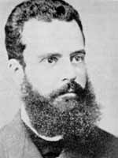
Pareto Analysis
Vilfredo Pareto observed that 80% of the land in Italy was owned by 20% of the population; others have noticed this trend elsewhere.
20% of the pea pods in Pareto’s garden contained 80% of the peas
Fixing 20% of bugs in software would eliminate 80% of crashes (Microsoft)
In the business world, typically 80% of business comes from 20% of the customers

Slide 16
Pareto Analysis
Workplace studies have shown
80% of tasks can be completed in 20% of your time; the remaining 20% of tasks require 80% of your time
80% of your productivity can be accomplished by 20% of your tasks
Therefore, the tasks requiring less of your time should be done first to maximize your productivity
Advantage: Emphasizes productivity
Disadvantage: Does not address long-term goals

Slide 17
Continuing Improvement…
Learning to manage time effectively is a process of continuing improvement
Long-term commitment to improvement is better than short bursts of organization and giving up when it doesn’t work perfectly.

